Slide 1
Mastering RAG: Advanced Architectures & Optimization
Duration: 4 Hours
Target: AI Engineers & Data Scientists
A Half-Day Intensive Workshop
Notes:
- **Opening Hook:** "By the end of today, you'll transform from building basic RAG systems to architecting production-ready, intelligent retrieval systems that can reason, self-correct, and autonomously solve complex problems."
- **Audience Check:** Quick show of hands - "Who has built a basic RAG system?" "Who has deployed RAG to production?" This helps gauge the room.
- **Set Expectations:** This is an intensive, technical workshop. We'll move fast through foundational concepts to spend time on advanced architectures.

Slide 2
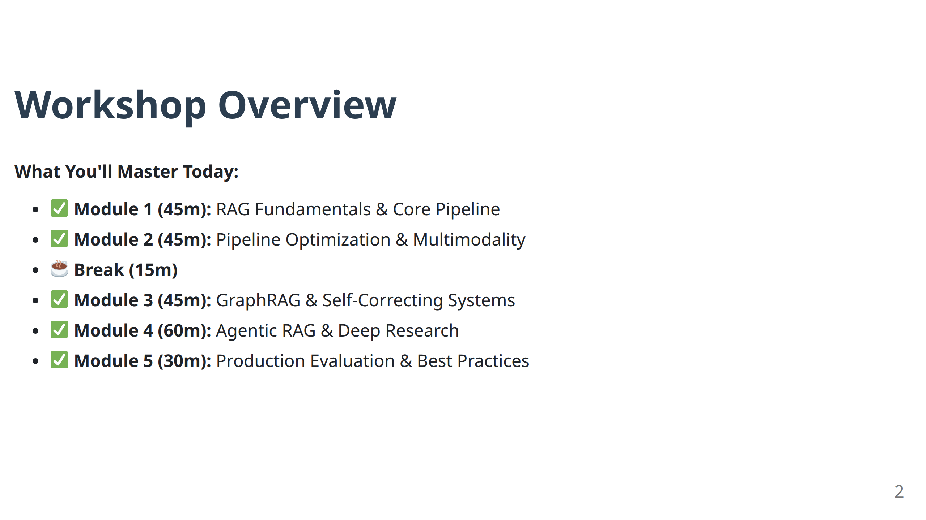
Notes:
- **Timing Emphasis:** Point out the 4-hour structure with specific module timings. The 15-minute break is strategically placed after covering optimization techniques.
- **Learning Path:** "We'll follow a progression from fixing basic RAG limitations to building autonomous AI agents that can research and reason."
- **Engagement:** "Each module builds on the previous - please ask questions as we go, but I'll also pause for Q&A at the end of each module."

Slide 3
Module 1
RAG Fundamentals & The Core Pipeline
Notes:
- **Transition:** "Even though you're here for advanced techniques, we need to establish a common foundation. The advanced architectures we'll cover later directly address the limitations we'll identify in this module."
- **Mindset:** "Think of this module as 'why advanced RAG exists' - every technique we'll learn later solves a specific problem with basic RAG."

Slide 4
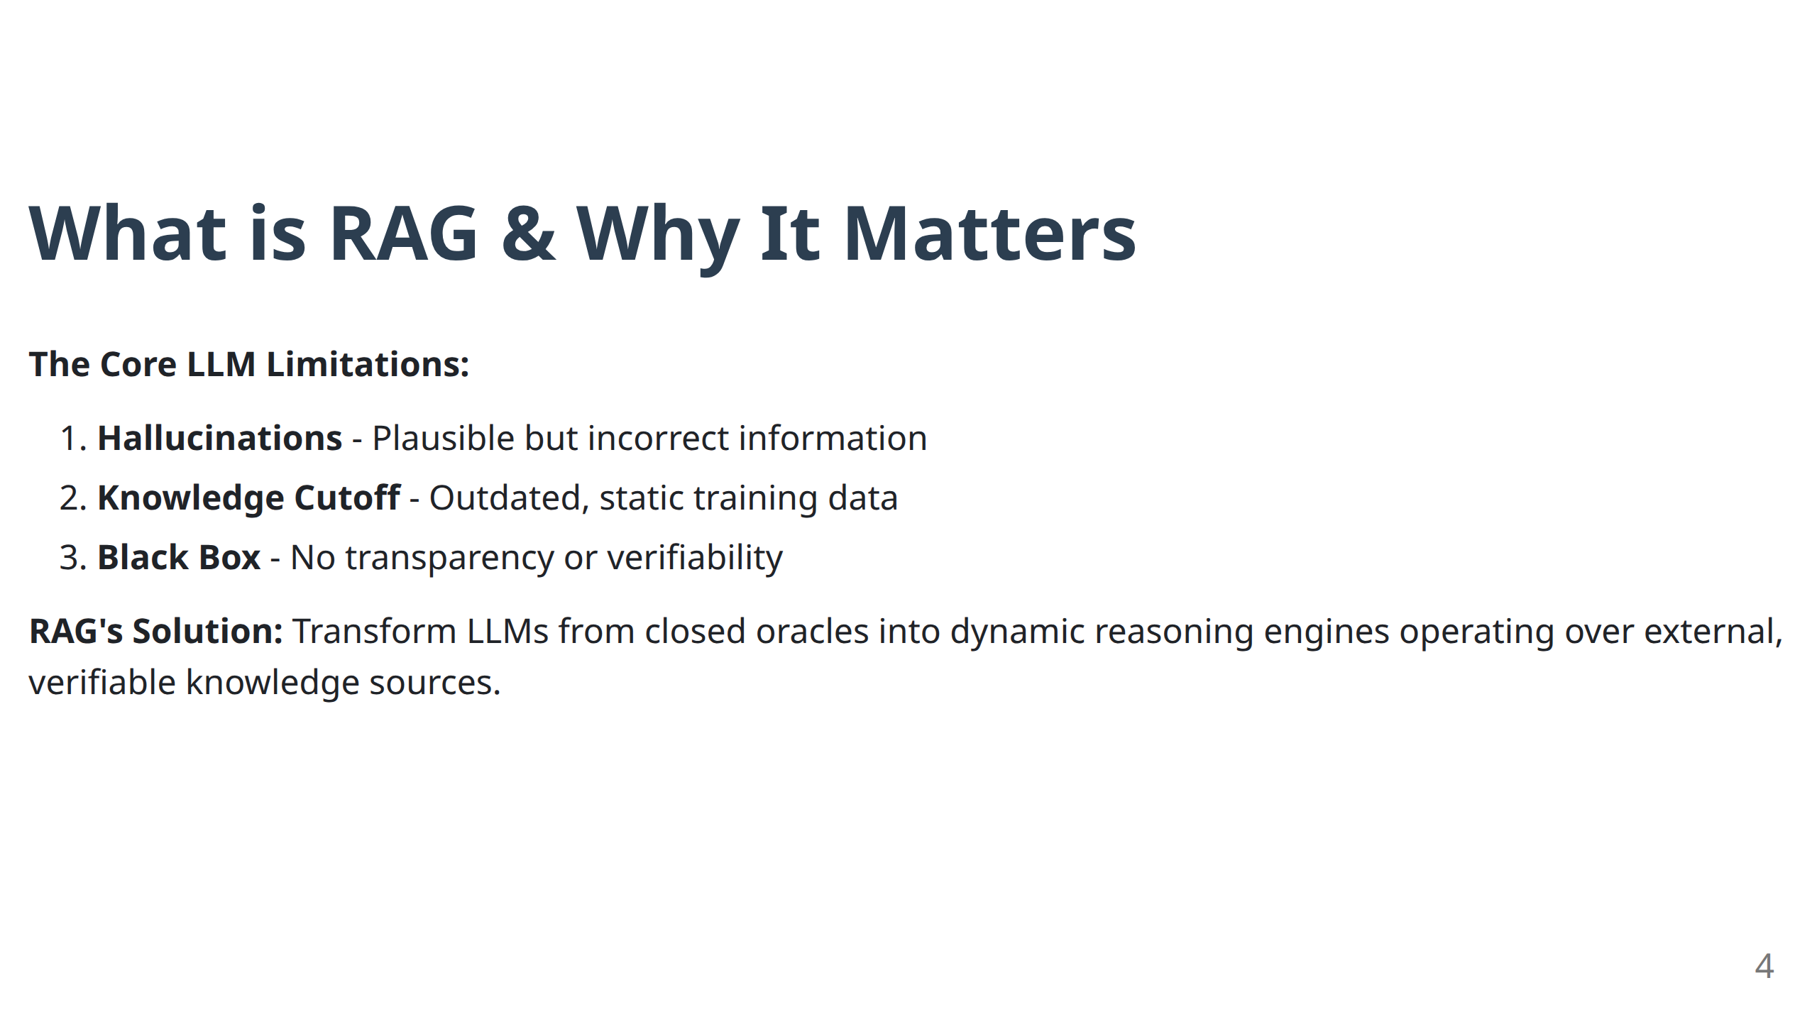
RAG addresses the hallucination problem in large language models but does not completely remove it. Instead, it shifts the challenge from hallucination to retrieval.
Notes:
- **Key Teaching Moment:** These three limitations are not just academic - they're deal-breakers for production systems.
- **Real-world Example:** "Imagine a customer service bot that confidently tells customers about a product feature that doesn't exist (hallucination), or a financial advisor that gives investment advice based on 2021 market data (knowledge cutoff)."
- **Transition Setup:** "RAG doesn't just fix these problems - it transforms how we think about AI systems."

Slide 5
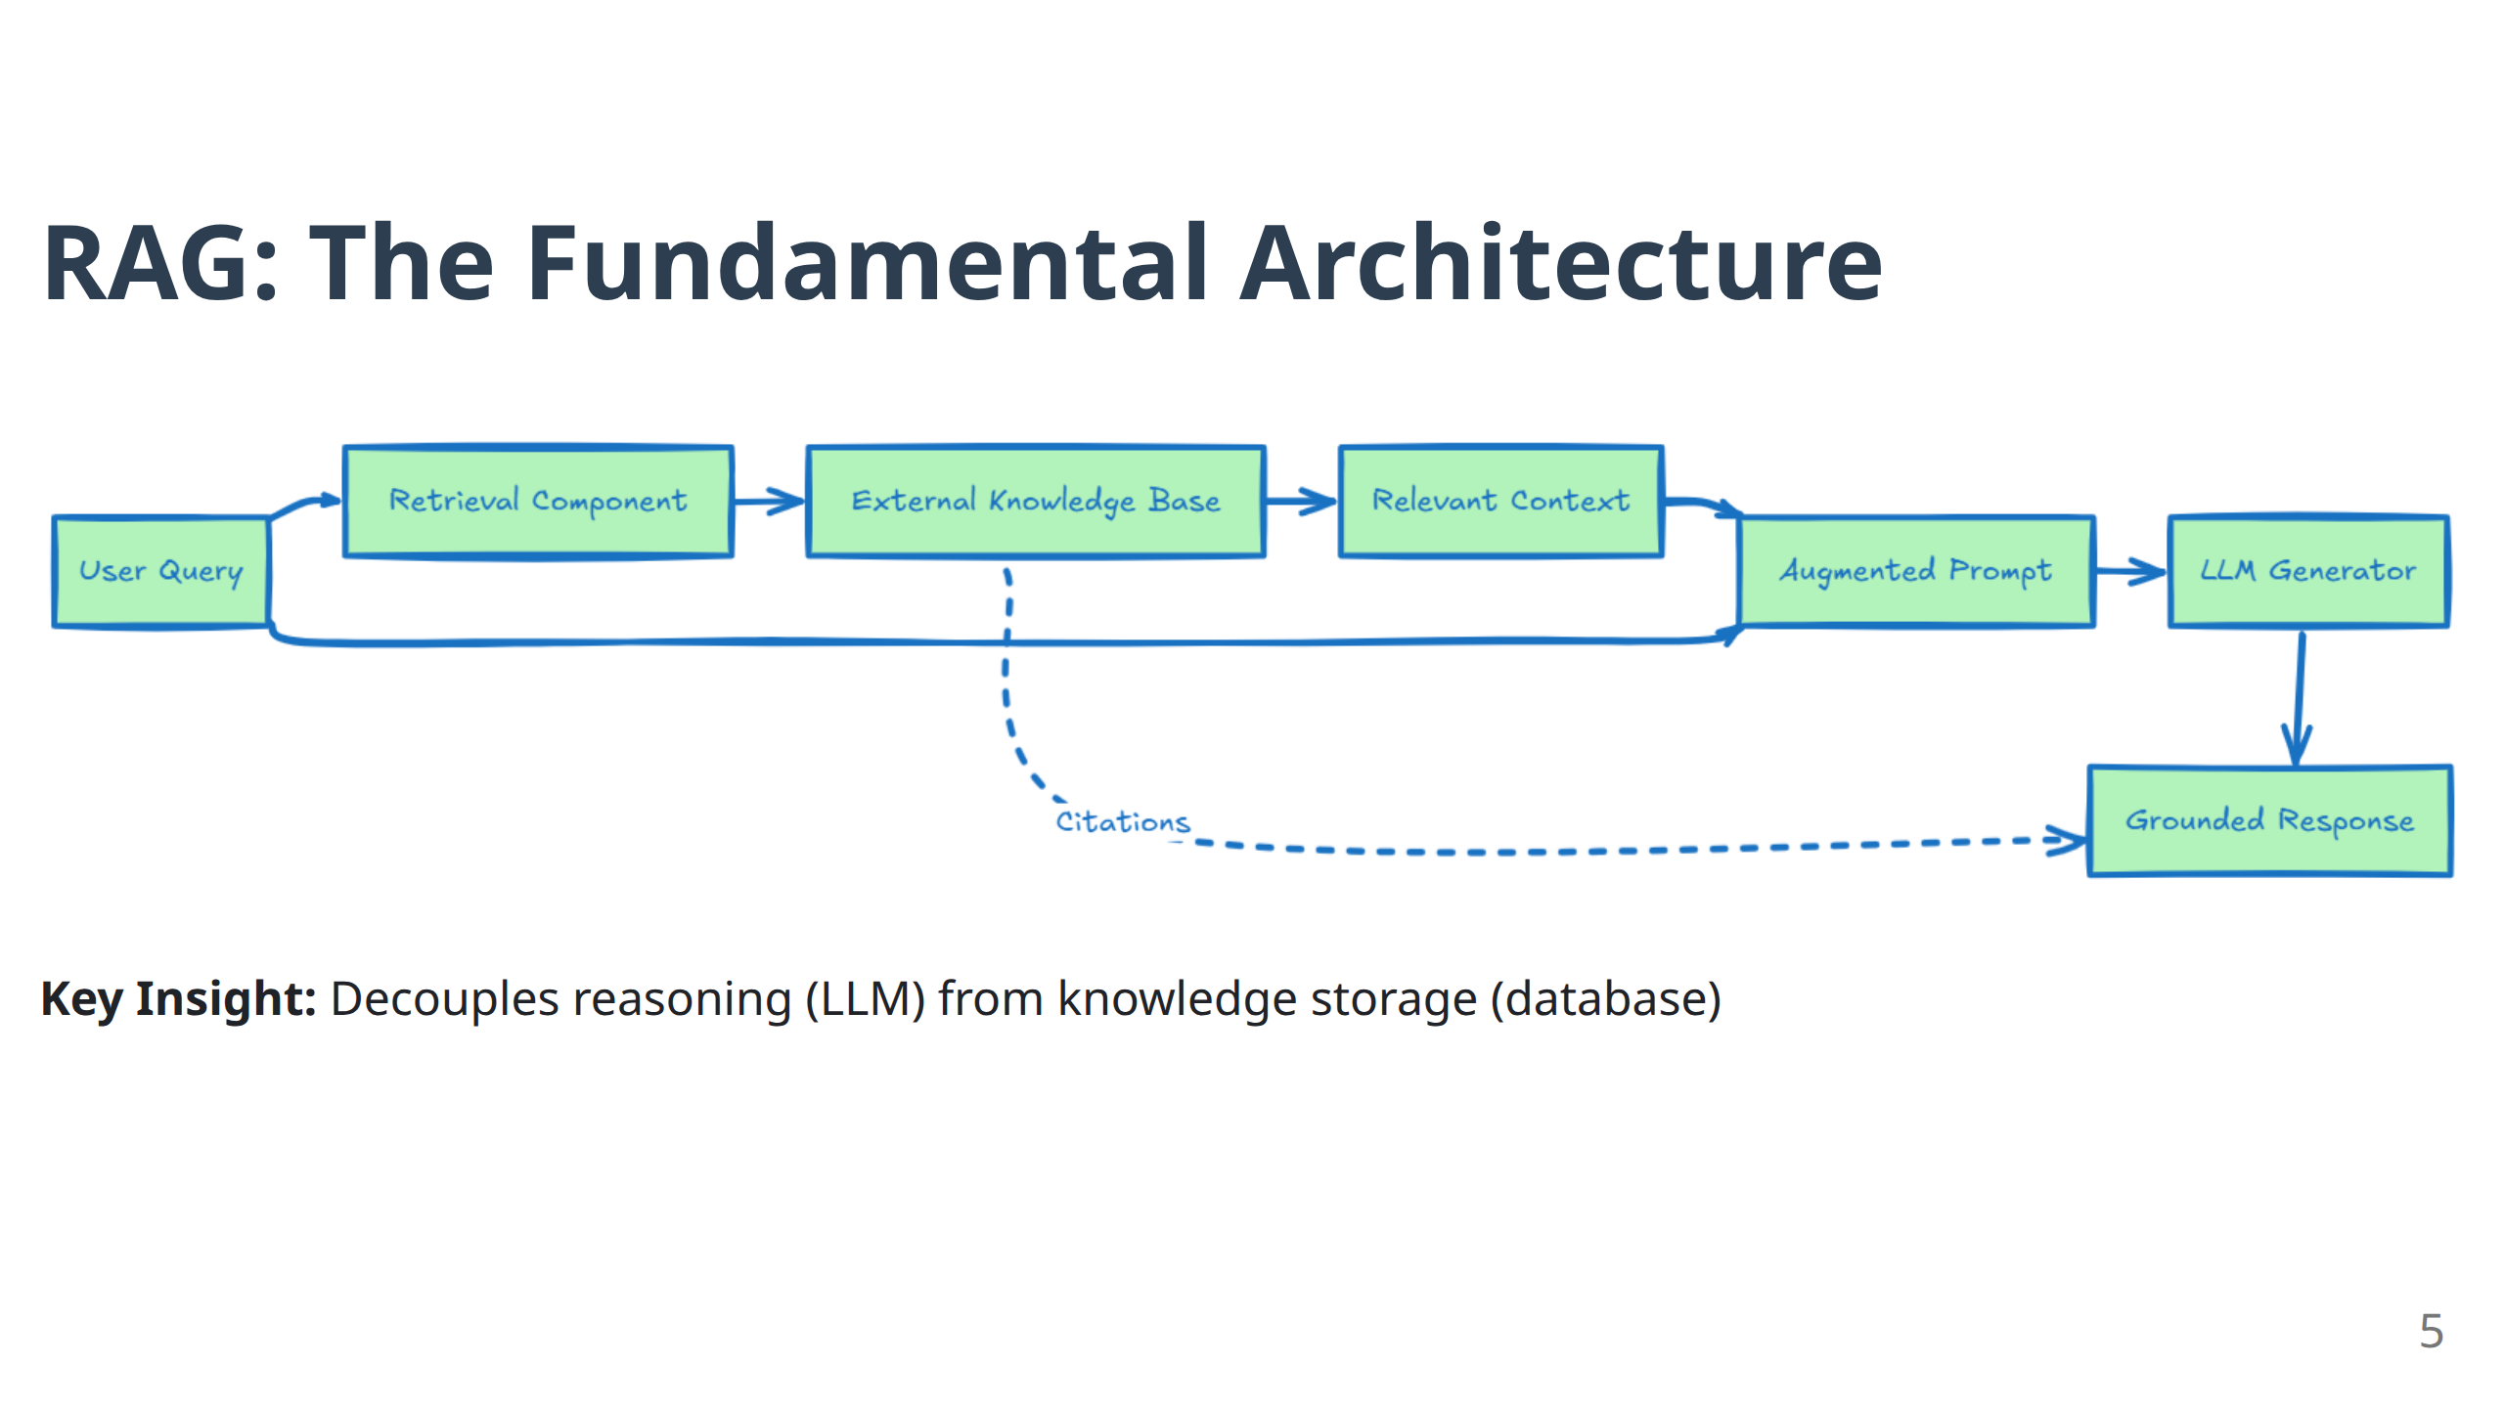
Notes:
### RAG: The Fundamental Architecture Slide
- **Diagram Walkthrough:** Point to each component in the Mermaid diagram. "Notice the bidirectional relationship - the LLM doesn't just receive context, it can also influence what gets retrieved in advanced systems."
- **Key Insight Emphasis:** "This decoupling is architectural gold. You can upgrade your knowledge base without touching the LLM, or swap in a better LLM without rebuilding your data pipeline."
- **Engagement Question:** "How many of you have struggled with keeping ML models updated with fresh data? RAG solves this elegantly."

Slide 6
RAG vs Fine-Tuning: Distinct Roles
RAG: Knowledge Injection
Dynamic factual updates
No model retraining
20x more cost-effective
External, verifiable sources
Use for: What to know
Fine-Tuning: Behaviour Adaptation
Style, tone, vocabulary
Expensive retraining required
Adapts model parameters
Task-specific formats
Use for: How to respond
Best Practice: Build robust RAG pipeline first, fine-tune style later.
6
Notes:
- **Common Misconception:** "I often see teams trying to fine-tune their way out of knowledge problems. That's like trying to memorize the entire internet."
- **Cost Reality Check:** "20x more cost-effective isn't hyperbole - I've seen teams spend $100K+ on fine-tuning for problems RAG solves for $5K."
- **Practical Advice:** "Start with RAG. Always. You can add fine-tuning later for style and domain-specific language, but never use it as your primary knowledge injection

Slide 7
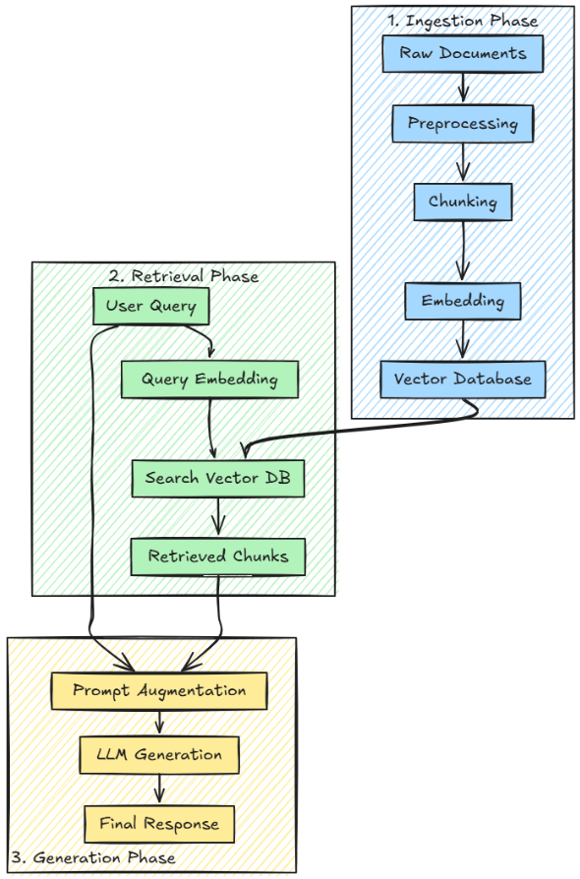
The Three-Phase RAG Pipeline
The RAG pipeline consists of three consecutive stages:
ingestion, which includes data loading, preprocessing, chunking, embedding, and indexing;
retrieval, where the system queries the vector database according to user input;
generation, which uses the retrieved chunks to produce contextually appropriate responses.
7
Notes:
- **Systems Thinking:** "This isn't just a workflow - it's a feedback system. Problems in ingestion compound in retrieval, which compound in generation."
- **Debugging Insight:** "When RAG fails in production, 70% of the time it's an ingestion problem that manifests as a generation problem."
- **Preview Advanced Concepts:** "In advanced architectures, these phases can repeat and interact in complex ways - agents might retrieve, generate, critique, then retrieve again."

Slide 8
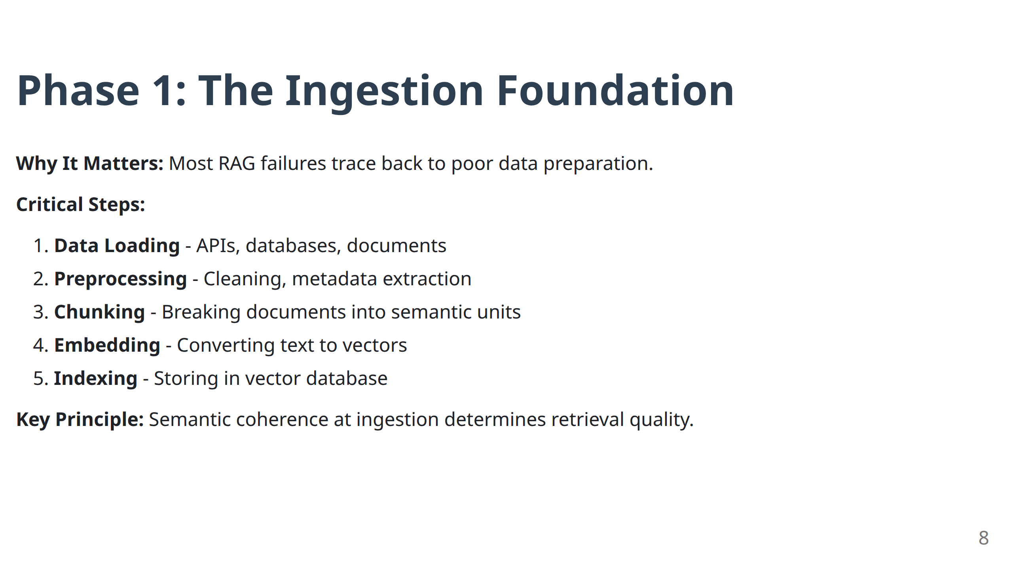
Notes:
- **Critical Truth:** "Most RAG failures I debug trace back to this phase. You can have the best retrieval algorithm in the world, but if you feed it semantically incoherent chunks, it will fail."
- **Metadata Importance:** "Don't overlook metadata extraction. Advanced systems use this for filtering, routing, and explainability."
- **Quality > Quantity:** "Better to have 1000 high-quality, well-chunked documents than 10,000 poorly processed ones."

Slide 9
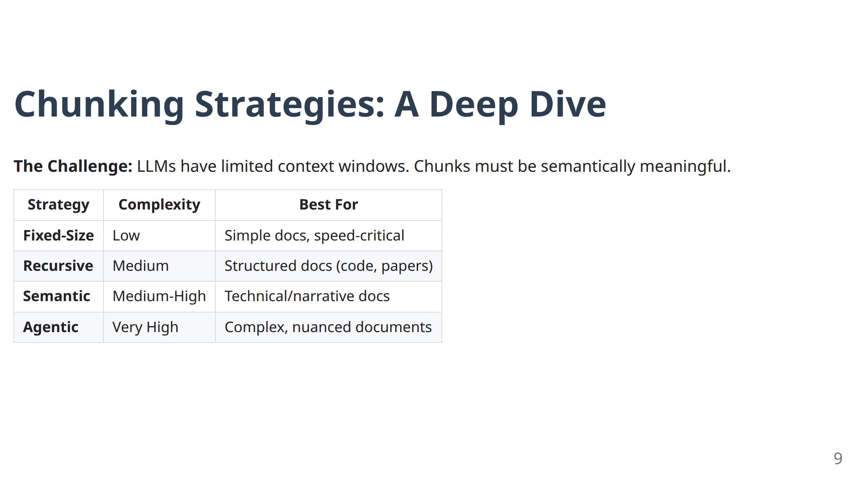
Notes:
- **Setup Importance:** "This table represents years of lessons learned. Chunking strategy is often the highest-impact decision you'll make in RAG system design."
- **Complexity vs. Benefit:** "Notice the complexity gradient. Start simple, measure performance, then optimize based on your specific domain."
- **Preview:** "In Module 4, we'll see agentic chunking in action - agents that decide how to chunk based on the intended use case."

Slide 10
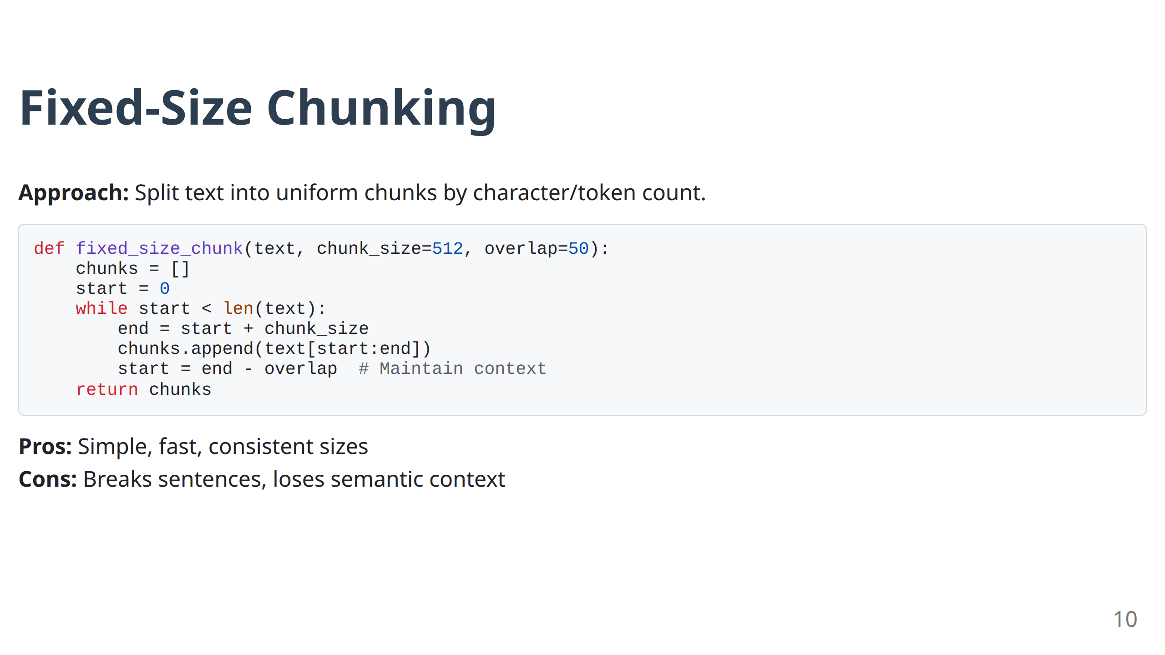
Notes:
- **When to Use:** "This is your starting point. Fast to implement, predictable behavior."
- **Code Walkthrough:** Point out the overlap parameter. "This overlap is crucial - it prevents important context from being split across chunks."
- **Limitation Example:** "Imagine this breaking a sentence in half: 'The company's revenue increased...' in one chunk and '...by 300% last quarter' in another. Semantic disaster."

Slide 11
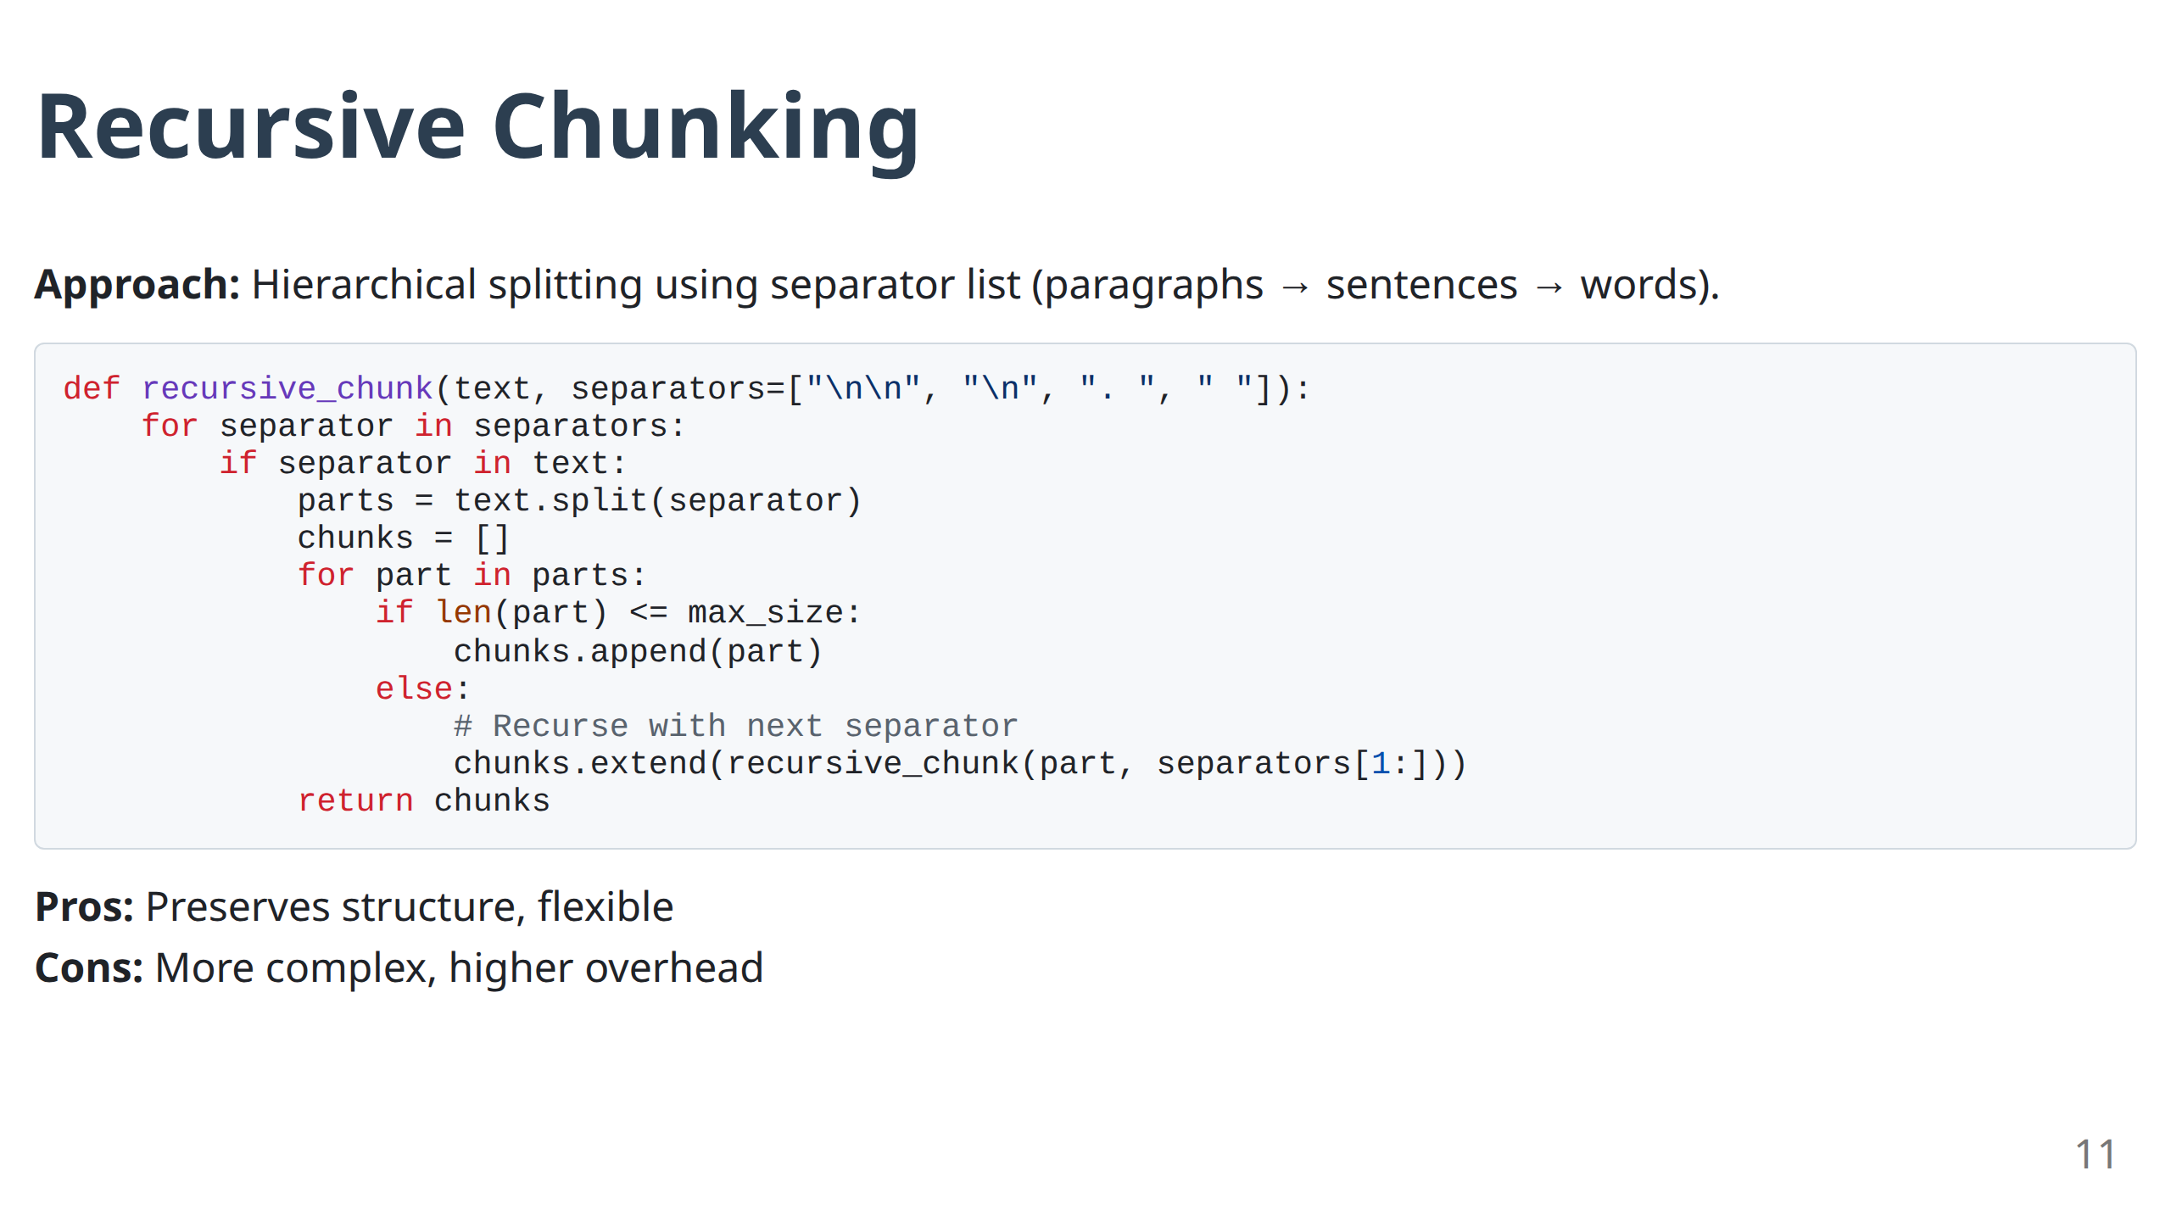
Notes:
- **Intelligence Layer:** "This adds structure awareness. It respects document hierarchy."
- **Code Insight:** "The separator list is order-dependent. It tries the largest semantic units first."
- **Use Case:** "Perfect for structured documents like technical manuals, legal documents, or code repositories."
- **Engagement:** "Anyone working with structured data will see immediate improvements switching from fixed-size to recursive."

Slide 12
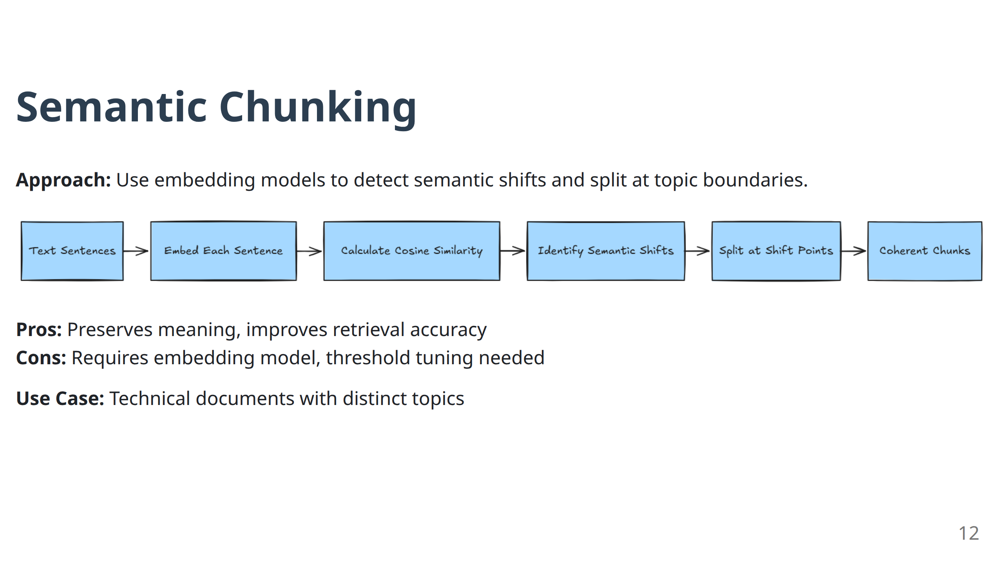
Notes:
- **Paradigm Shift:** "Now we're using AI to improve AI. The embedding model helps us understand topic boundaries."
- **Threshold Tuning:** "The magic is in the threshold. Too sensitive = tiny chunks. Too loose = huge chunks."
- **Trade-off Reality:** "Yes, it's more expensive computationally, but the retrieval quality improvement is often worth 2-3x the cost."
- **Real-world Win:** "I've seen semantic chunking improve answer quality by 40% for technical documentation."

Slide 13
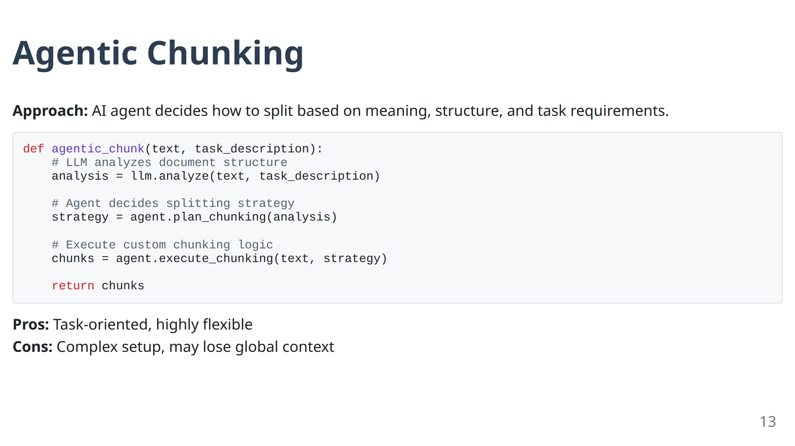
Notes:
- **Future Preview:** "This is where we're heading - AI systems that adapt their processing based on the task."
- **Complexity Warning:** "High reward, high complexity. Only consider this for mission-critical applications."
- **Example:** "An agent processing legal contracts might chunk differently for compliance review vs. risk assessment."

Slide 14
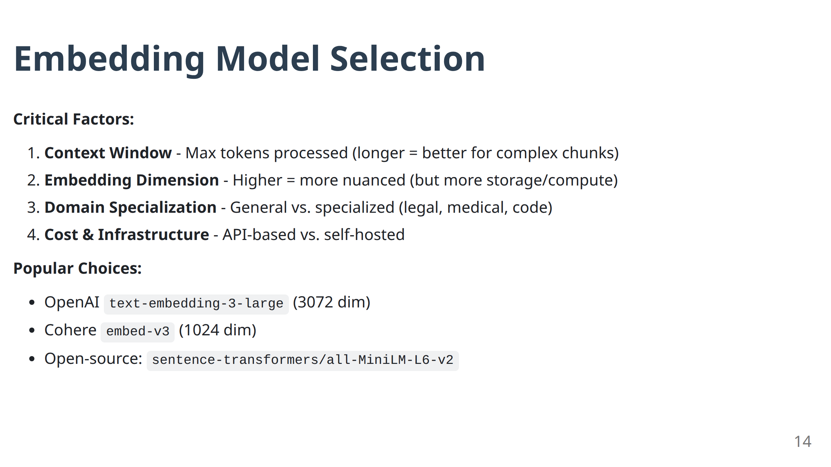
Notes:
- **Critical Decision:** "Your embedding model choice ripples through your entire system. It's worth spending time here."
- **Context Window Reality:** "If your chunks are 1000 tokens but your embedding model only handles 512, you're truncating valuable context."
- **Domain Matching:** "General models work for most use cases, but domain-specific models can provide 20-30% better retrieval for specialized fields."
- **Cost Consideration:** "API-based models are convenient but can get expensive at scale. Budget accordingly."

Slide 15
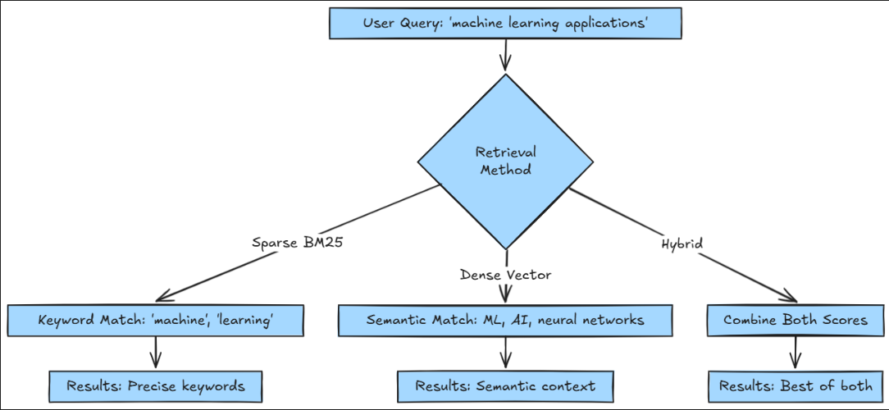
Phase 2: Retrieval Methods Compared
The Evolution: Sparse → Dense → Hybrid
15
Notes:
- **Evolution Story:** "This evolution from sparse to dense to hybrid mirrors the broader AI evolution from symbolic to neural to hybrid systems."
- **No Silver Bullet:** "Each method has strengths. The goal isn't to pick one but to understand when to use each."
- **Production Reality:** "In production, you'll likely use all three at different times or in combination."

Slide 16
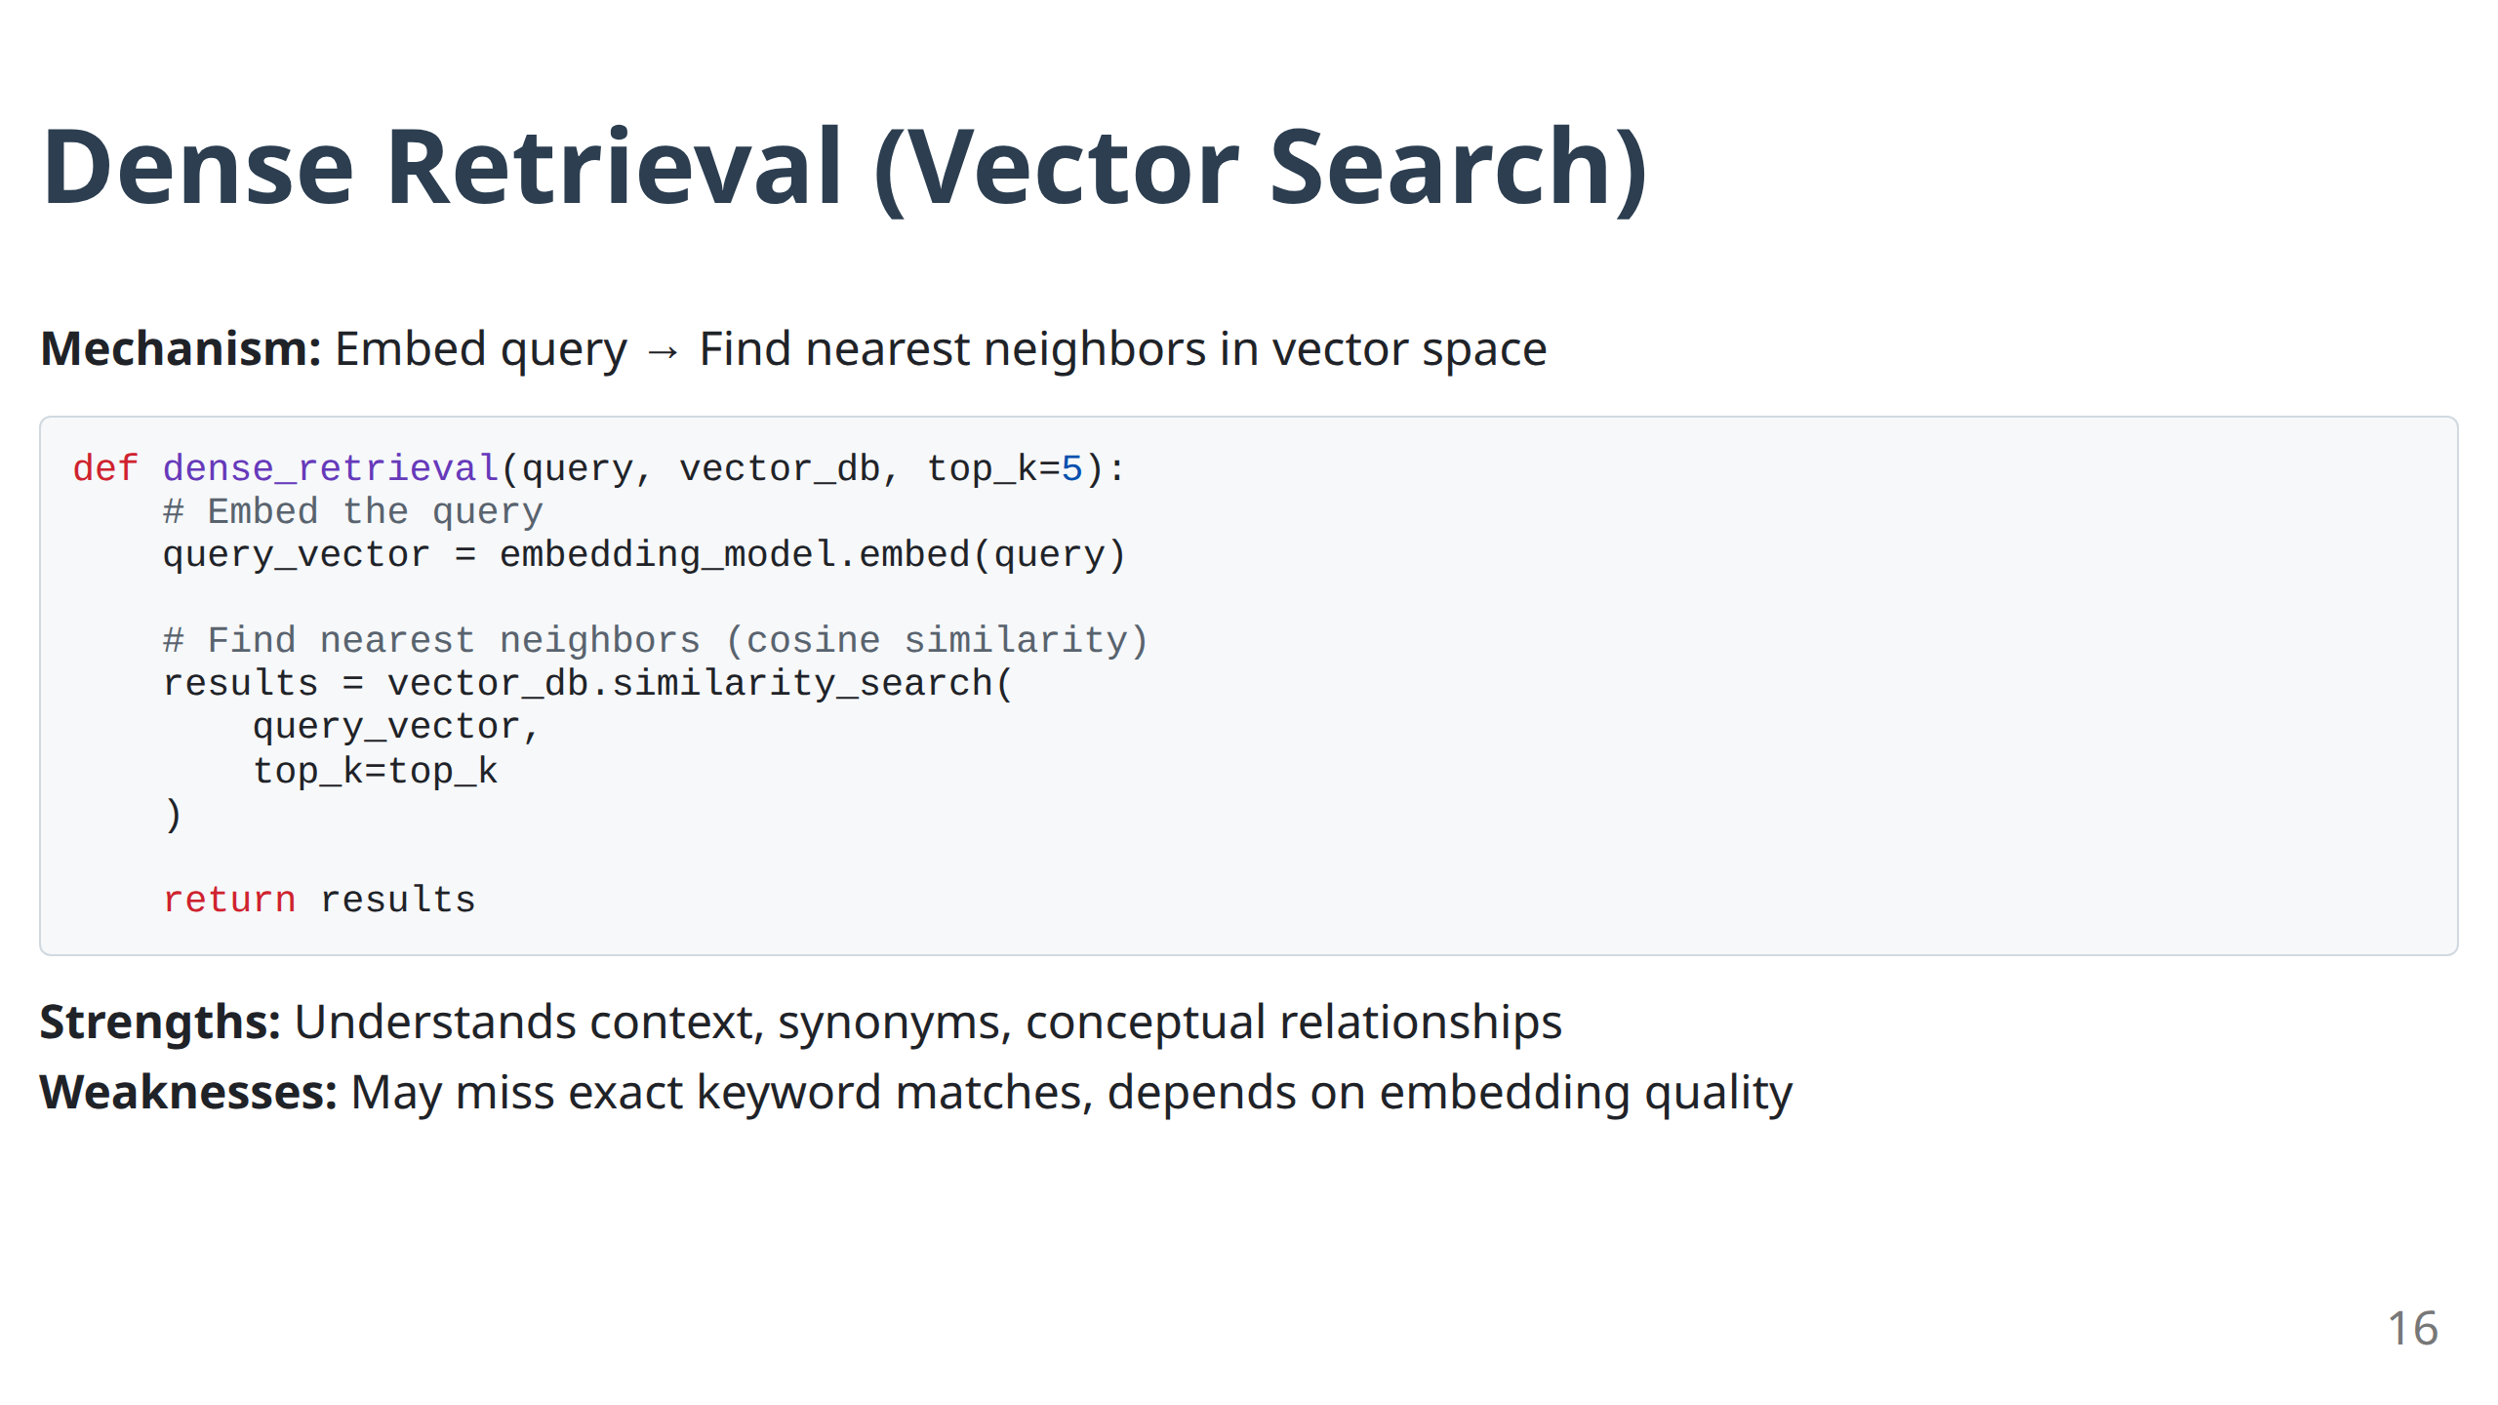
Notes:
- **Semantic Power:** "This is what makes modern RAG possible. It understands meaning, not just words."
- **Example Magic:** "Ask about 'car' and it finds documents about 'automobile', 'vehicle', 'transportation'. Keyword search can't do this."
- **Limitation Example:** "But ask for 'AWS S3' and it might miss documents that only mention 'Simple Storage Service' without the acronym."
- **Code Insight:** "The top_k parameter is tunable. More isn't always better - more results = more noise for the LLM to process."

Slide 17
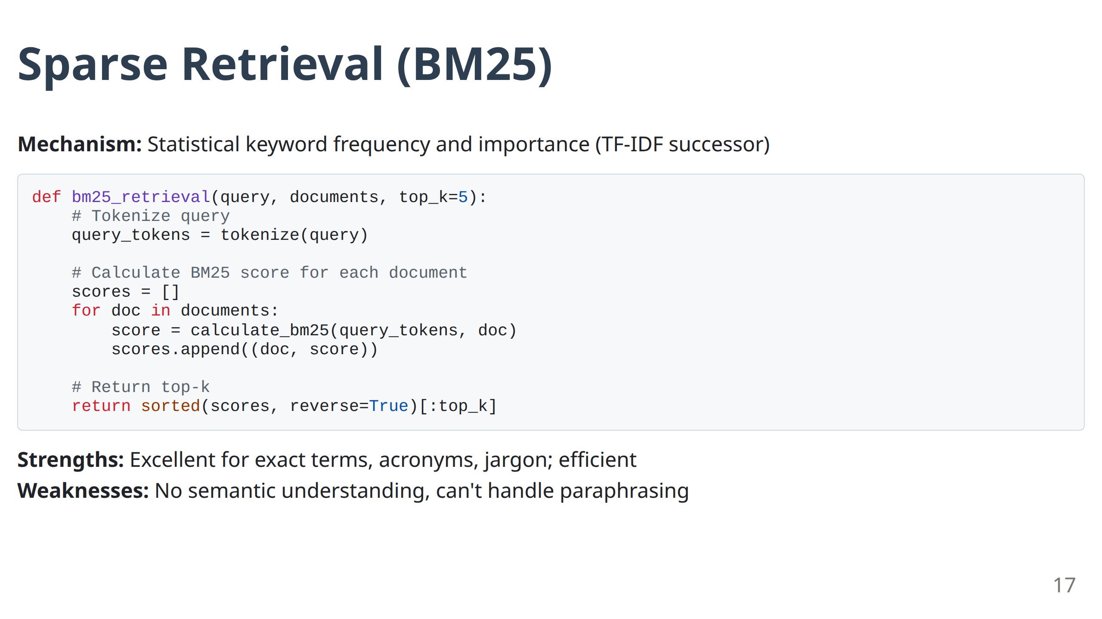
Notes:
- **Underappreciated Workhorse:** "BM25 is TF-IDF's smarter cousin. It's been powering search engines for decades."
- **Precision Champion:** "When users search for specific terms, acronyms, or product codes, BM25 is unbeatable."
- **Speed Advantage:** "Orders of magnitude faster than vector search. Critical for real-time applications."
- **Limitation:** "Zero semantic understanding. Searches for 'happy' won't find 'joyful'."

Slide 18
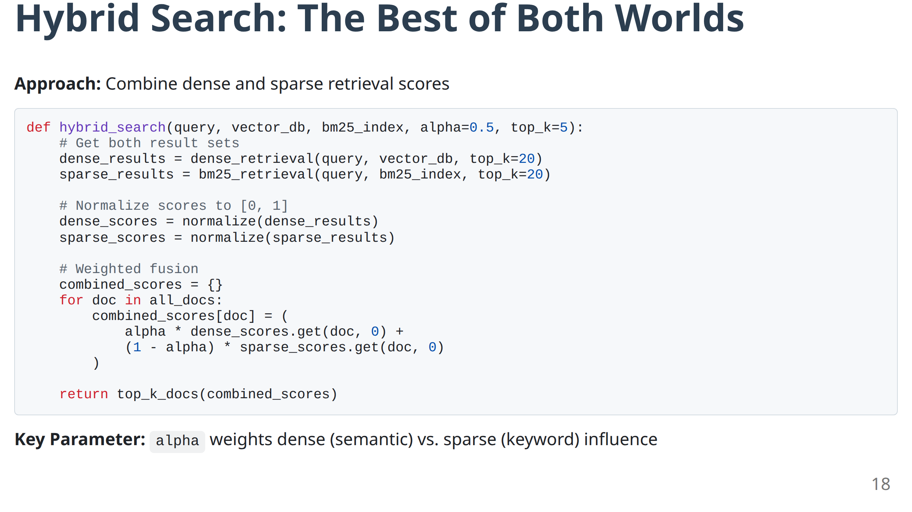
Notes:
- **Production Standard:** "This is becoming the default approach for production RAG systems."
- **Alpha Parameter:** "This is your tuning knob. Start at 0.5, then adjust based on your domain. Legal documents might need more sparse (exact terms matter), creative content might need more dense (concepts matter)."
- **Implementation Reality:** "Yes, it's more complex to implement, but the performance gains justify the complexity."
- **Normalization Importance:** "The normalization step is crucial - you're combining scores from different algorithms."

Slide 19
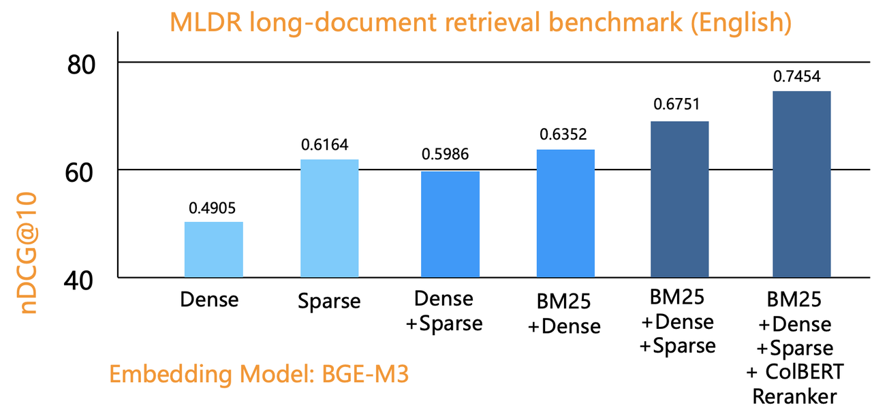
Hybrid Search: Performance Comparison
Source: https://infiniflow.org/blog/best-hybrid-search-solution
Empirical Finding: Hybrid consistently outperforms single methods across diverse query types.
Production Recommendation: Start with 50/50 weighting (α=0.5), then tune based on your domain.
19
Notes:
- **Data Tells the Story:** "This visualization represents aggregate performance across multiple domains and query types."
- **Consistency Wins:** "Notice hybrid's consistent performance. It rarely has the absolute best score, but it rarely fails badly either."
- **Risk Mitigation:** "In production, consistency often matters more than peak performance."
- **Tuning Opportunity:** "The default 50/50 weighting is a starting point, not an ending point."

Slide 20
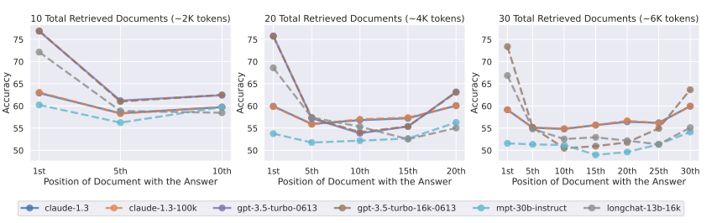
Phase 3: Generation & The "Lost in the Middle" Problem
Challenge: LLMs exhibit attentional bias - prioritize information at prompt edges.
Source: Lost in the Middle: How Language Models Use Long Contexts | Image: Nelson F. Liu et al.
Implication: Retrieved chunk order matters. Most critical information should be placed at beginning and end of context.
Solution Preview: Post-retrieval re-ranking (Module 2)
20
Notes:
- **Architectural Limitation:** "This isn't a bug - it's how transformer attention works. The model literally pays less attention to middle content."
- **Visualization Impact:** Show with hands how attention drops in the middle.
- **Production Implication:** "This is why post-retrieval optimization (Module 2) is so important. We need to strategically place the most important information."
- **Preview:** "Advanced systems use this knowledge to re-order retrieved chunks before generation."

Slide 21
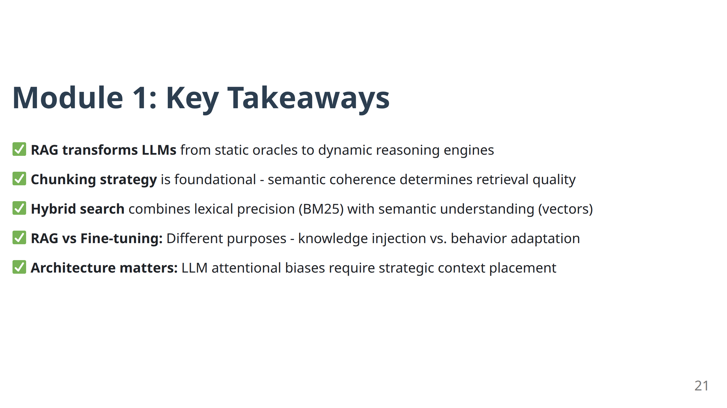
Notes:
- **Synthesis Moment:** "Let's connect the dots. We've established that RAG transforms LLMs, but basic RAG has limitations."
- **Foundation Complete:** "You now understand why every advanced technique we'll cover exists - they all solve specific problems with this basic pipeline."
- **Transition:** "Module 2 is about making this pipeline production-ready through optimization."
- **Q&A Time:** "Any questions about the fundamentals before we move to optimization?"

Slide 22
Module 2
Optimizing the Pipeline & Handling Multimodality
Notes:
- **Mindset Shift:** "Module 1 was about understanding RAG. Module 2 is about making RAG work reliably at scale."
- **Production Focus:** "These aren't academic optimizations - these are battle-tested techniques from production systems."

Slide 23
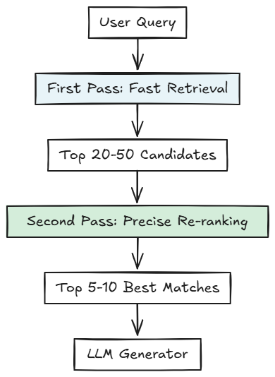
Post-Retrieval Optimization: The Two-Pass Pattern
Architecture: Recall-then-Precision Funnel
Trade-off: Speed (first pass) vs. Accuracy (second pass)
23
Notes:
- **Engineering Principle:** "This is a classic computer science pattern - optimize for different objectives in different passes."
- **First Pass Goal:** "Cast a wide net quickly. We want high recall - don't miss anything important."
- **Second Pass Goal:** "Be selective carefully. We want high precision - only the best makes it to the LLM."
- **Analogy:** "Like a funnel - wide at the top, narrow at the bottom."

Slide 24
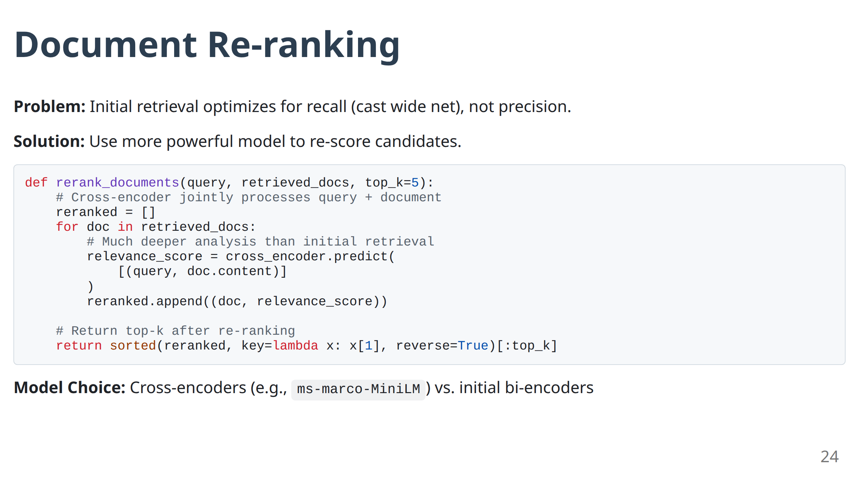
Notes:
- **Problem Framing:** "Initial retrieval is optimized for speed. But speed and accuracy often conflict."
- **Solution Elegance:** "Use a fast model to get candidates, then a slow, accurate model to pick the best."
- **Cross-encoder Power:** "Cross-encoders can see the query and document together. This joint processing gives much better relevance judgments."
- **Real Impact:** "I've seen re-ranking improve precision by 50-70% with only 20% latency increase."

Slide 25
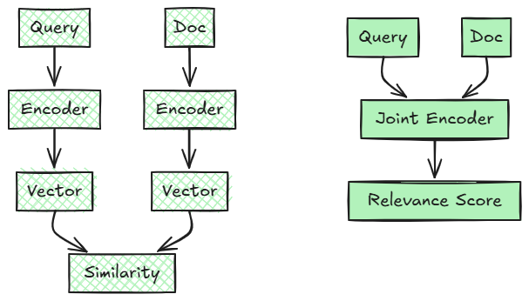
Re-ranking: Bi-Encoder vs Cross-Encoder
Bi-Encoder (Initial Retrieval)
Cross-Encoder (Re-ranking)
Trade-off: Bi-encoder is fast but less accurate; Cross-encoder is slow but highly accurate.
25
Notes:
- **Architecture Trade-off:** "Bi-encoders are fast because they can pre-compute document embeddings. Cross-encoders are accurate because they jointly process query and document."
- **Production Strategy:** "Use bi-encoders for initial retrieval (can pre-compute), cross-encoders for re-ranking (must compute at query time)."
- **Visual Learning:** The diagrams make this trade-off clear.
- **Scaling Consideration:** "Cross-encoders don't scale to millions of documents, but they work great on the top 20-50 candidates."

Slide 26
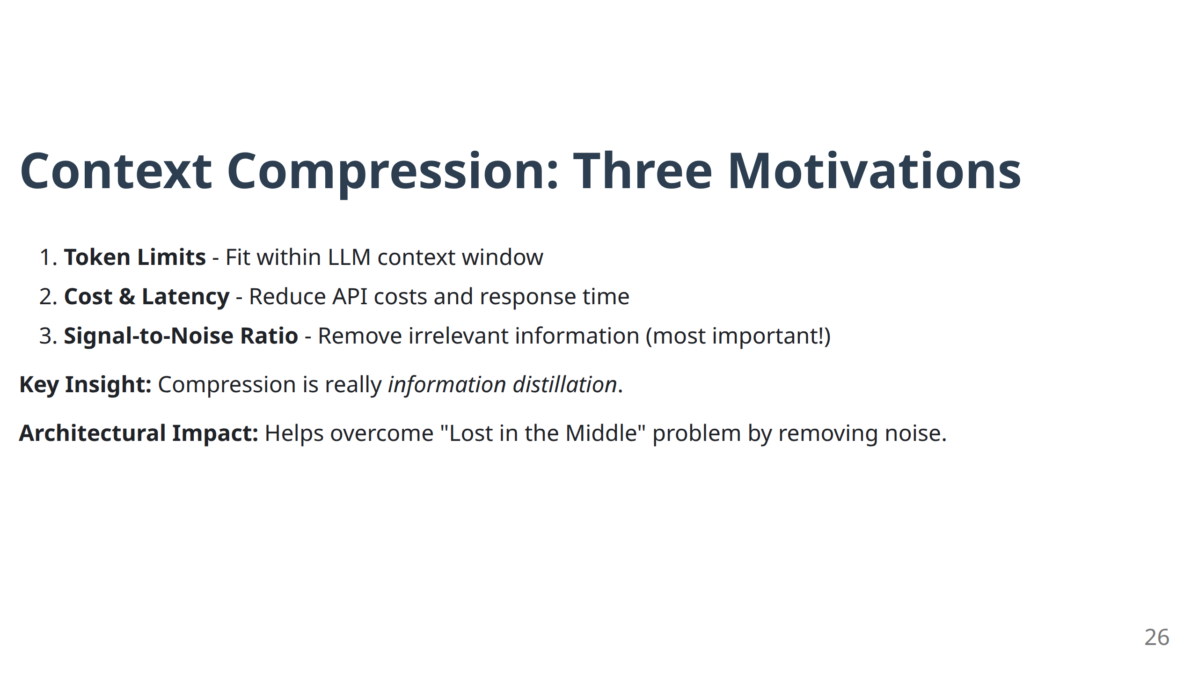
Notes:
- **Motivation Hierarchy:** "List these in order of importance for your use case. Token limits are obvious, but signal-to-noise ratio is often more important."
- **Information Distillation:** "Think of compression as distillation, not just removal. We're concentrating the useful information."
- **Lost in the Middle Solution:** "Compression helps solve the attention bias problem by removing irrelevant content."

Slide 27
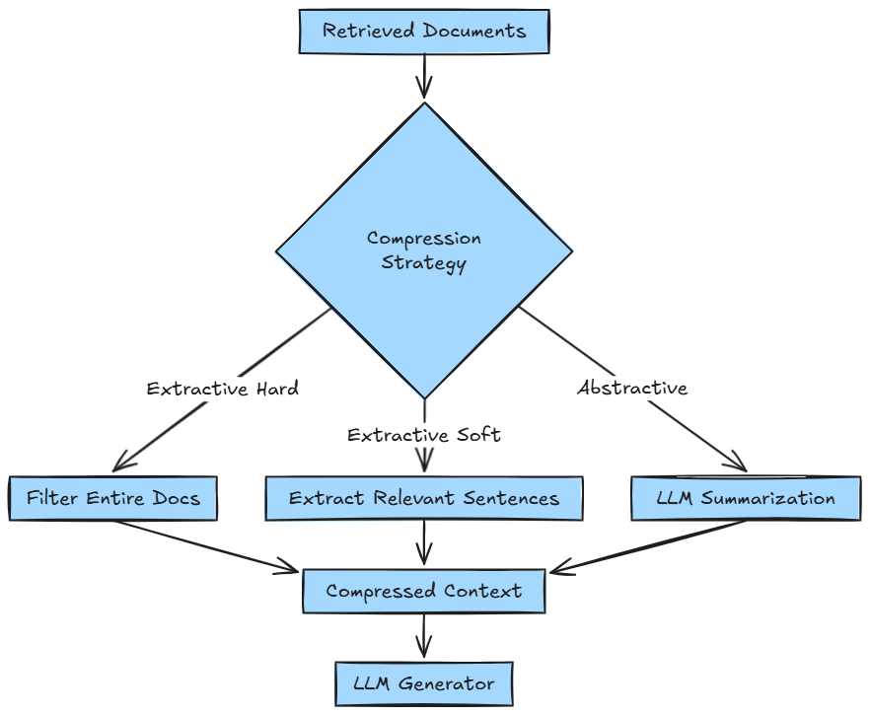
Context Compression Techniques
Choice Factors: Quality requirements, latency tolerance, cost constraints
27
Notes:
- **Strategy Spectrum:** "These represent different points on the speed-quality spectrum."
- **Hard Filtering:** "Binary decisions. Fast but crude."
- **Soft Extraction:** "More nuanced. Preserves some original text."
- **Abstractive:** "Most intelligent but also most expensive and risky."
- **Choice Framework:** "Choose based on your latency tolerance and quality requirements."

Slide 28
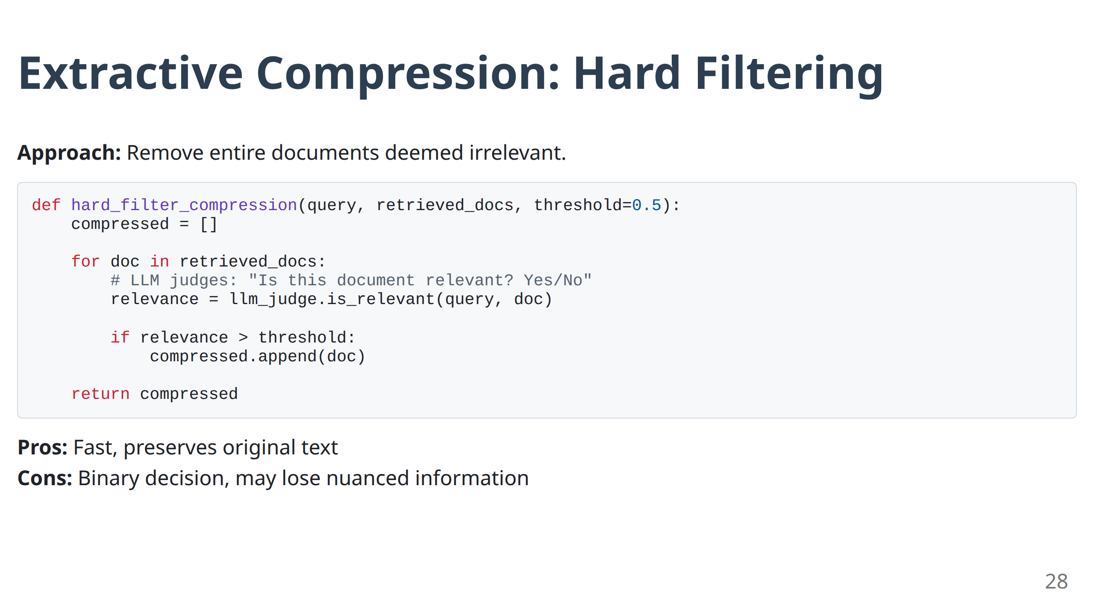
Notes:
- **Binary Decision:** "This is yes/no filtering at the document level."
- **Speed Advantage:** "Very fast - one LLM call per document."
- **Use Case:** "Great when you have many documents but only a few are truly relevant."
- **Limitation:** "All-or-nothing. You might lose documents with both relevant and irrelevant sections."

Slide 29
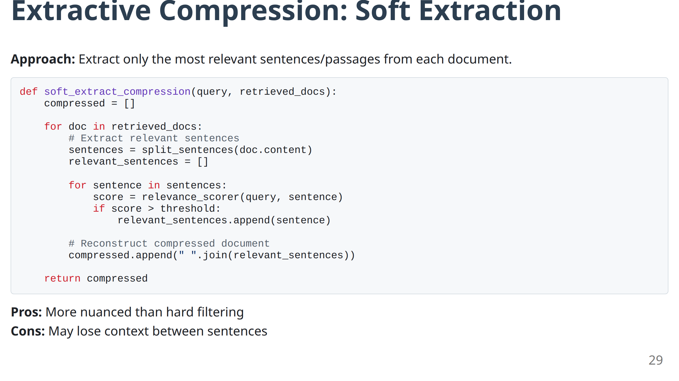
Notes:
- **Granularity Benefit:** "Now we're working at the sentence or paragraph level, not document level."
- **Context Preservation:** "Better than hard filtering because we keep the relevant parts of partially relevant documents."
- **Implementation Tip:** "The relevance_scorer can be a simple model - even a lightweight classifier works well here."
- **Balance Point:** "Good compromise between speed and quality."

Slide 30
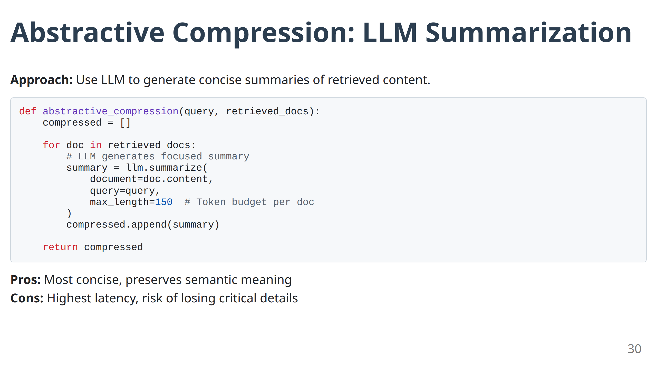
Notes:
- **Intelligence Maximum:** "This is the most sophisticated approach - the LLM understands the content and creates a focused summary."
- **Quality Peak:** "Often produces the best results because it preserves semantic meaning while being very concise."
- **Risk Factor:** "But the LLM could hallucinate or miss critical details during summarization."
- **Cost Reality:** "Most expensive approach - requires LLM inference for every document."

Slide 31
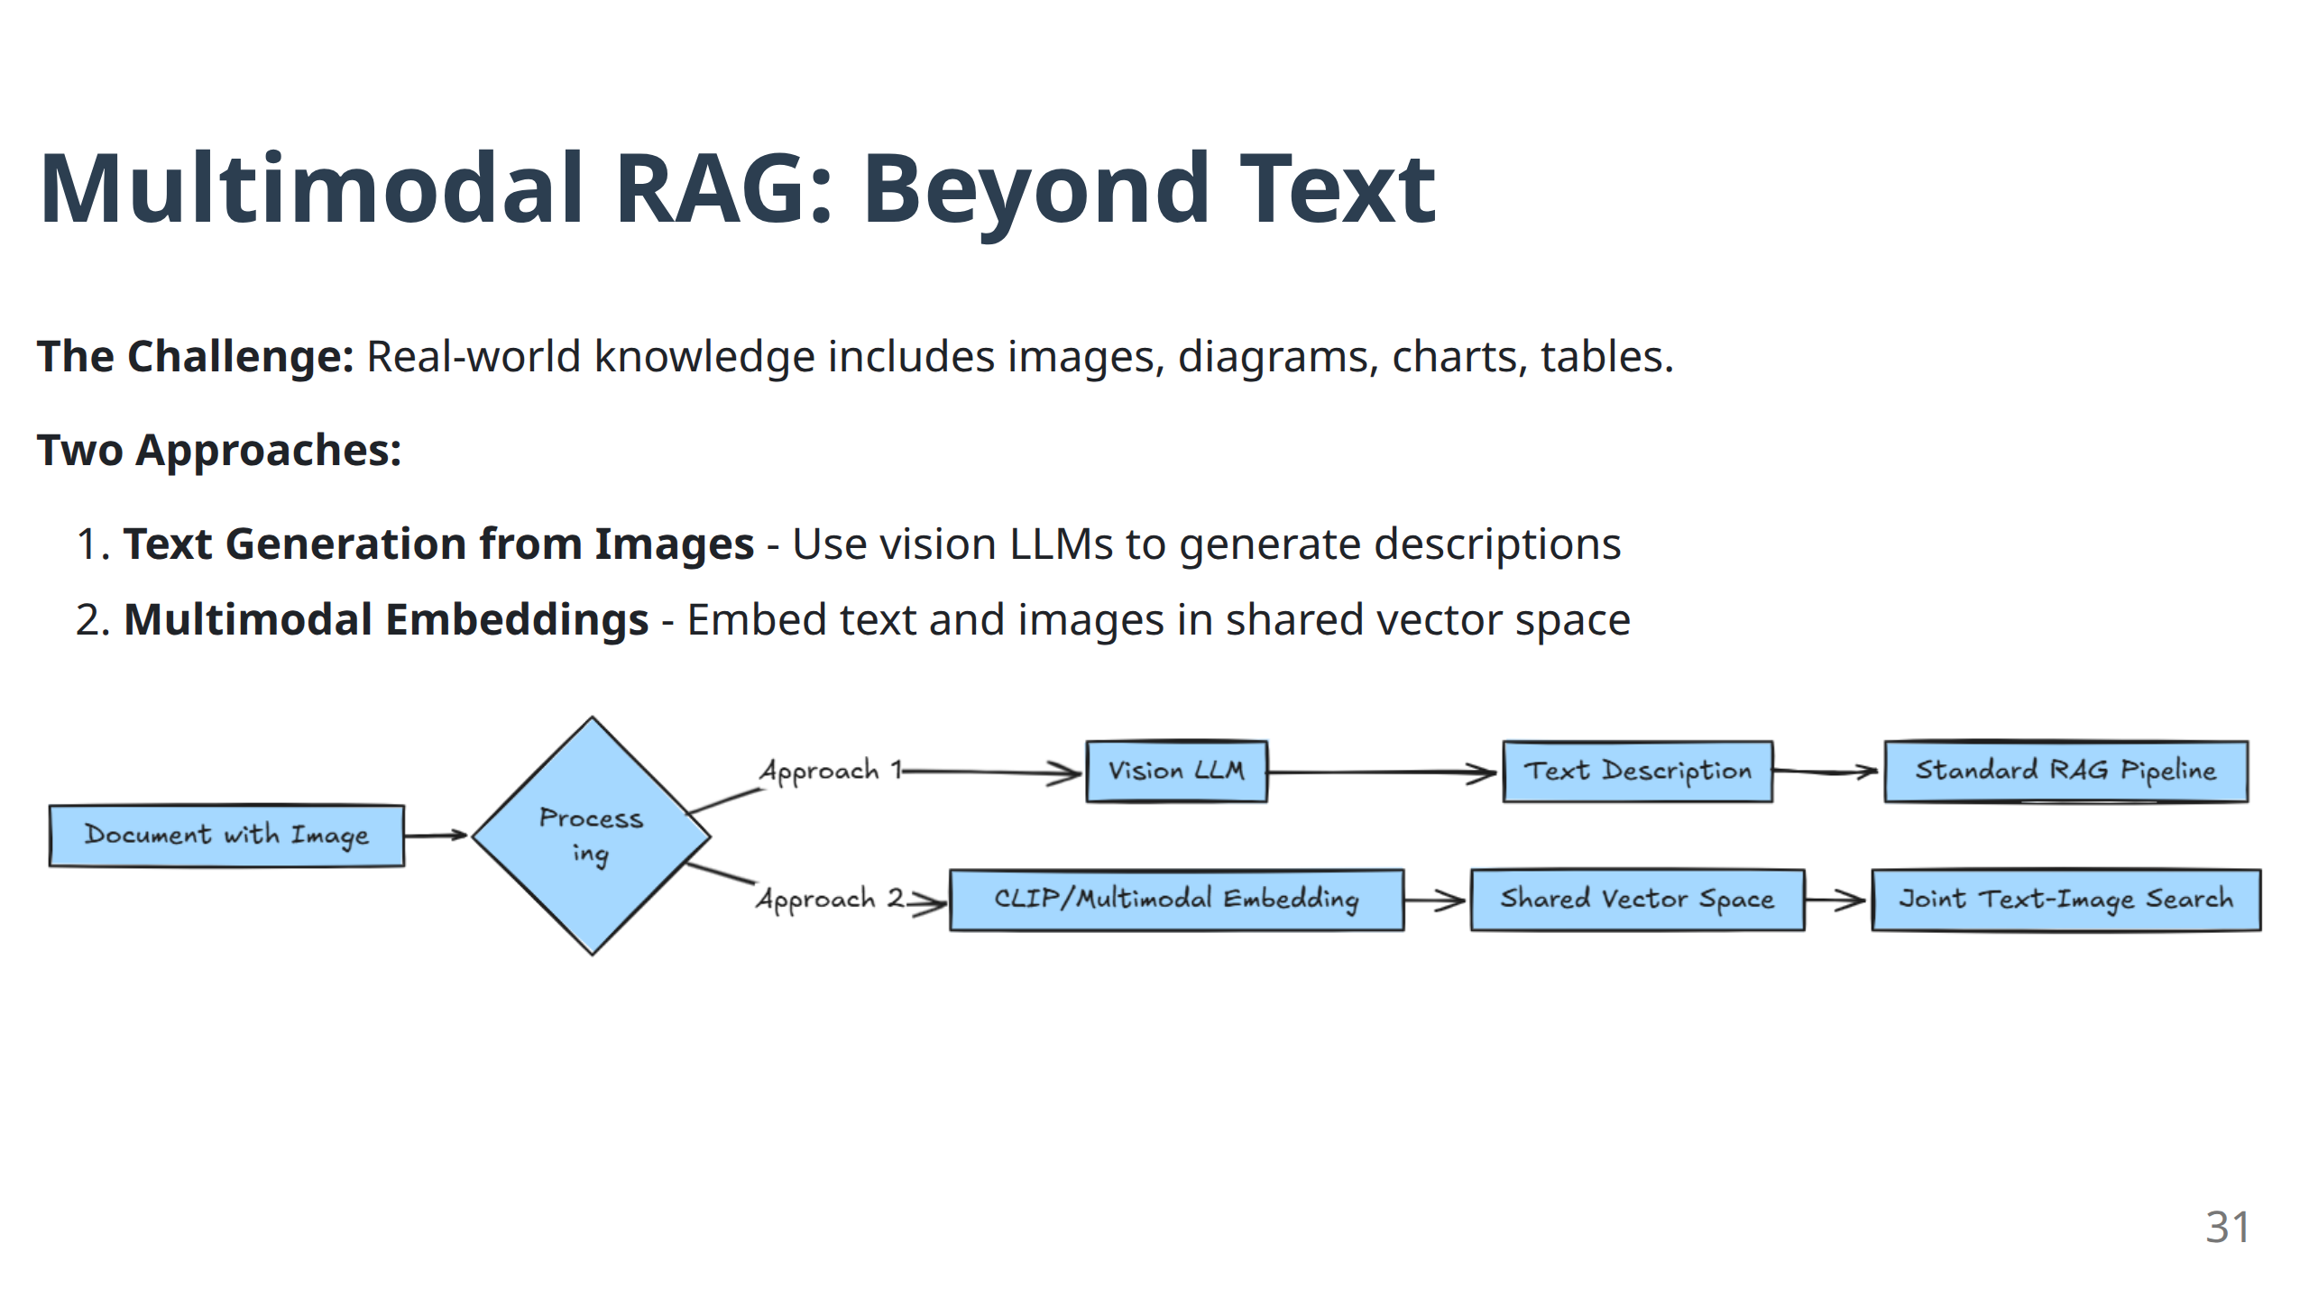
Notes:
- **Reality Check:** "Most enterprise knowledge isn't pure text. Think about your own documentation - charts, diagrams, screenshots are everywhere."
- **Two-Path Strategy:** "These aren't competing approaches - often you'll use both in the same system."
- **Vision LLM Approach:** "Convert everything to text, then use standard RAG. Simple but potentially lossy."
- **Multimodal Embedding:** "Keep images as images, but search across both modalities. More complex but preserves full information."

Slide 32
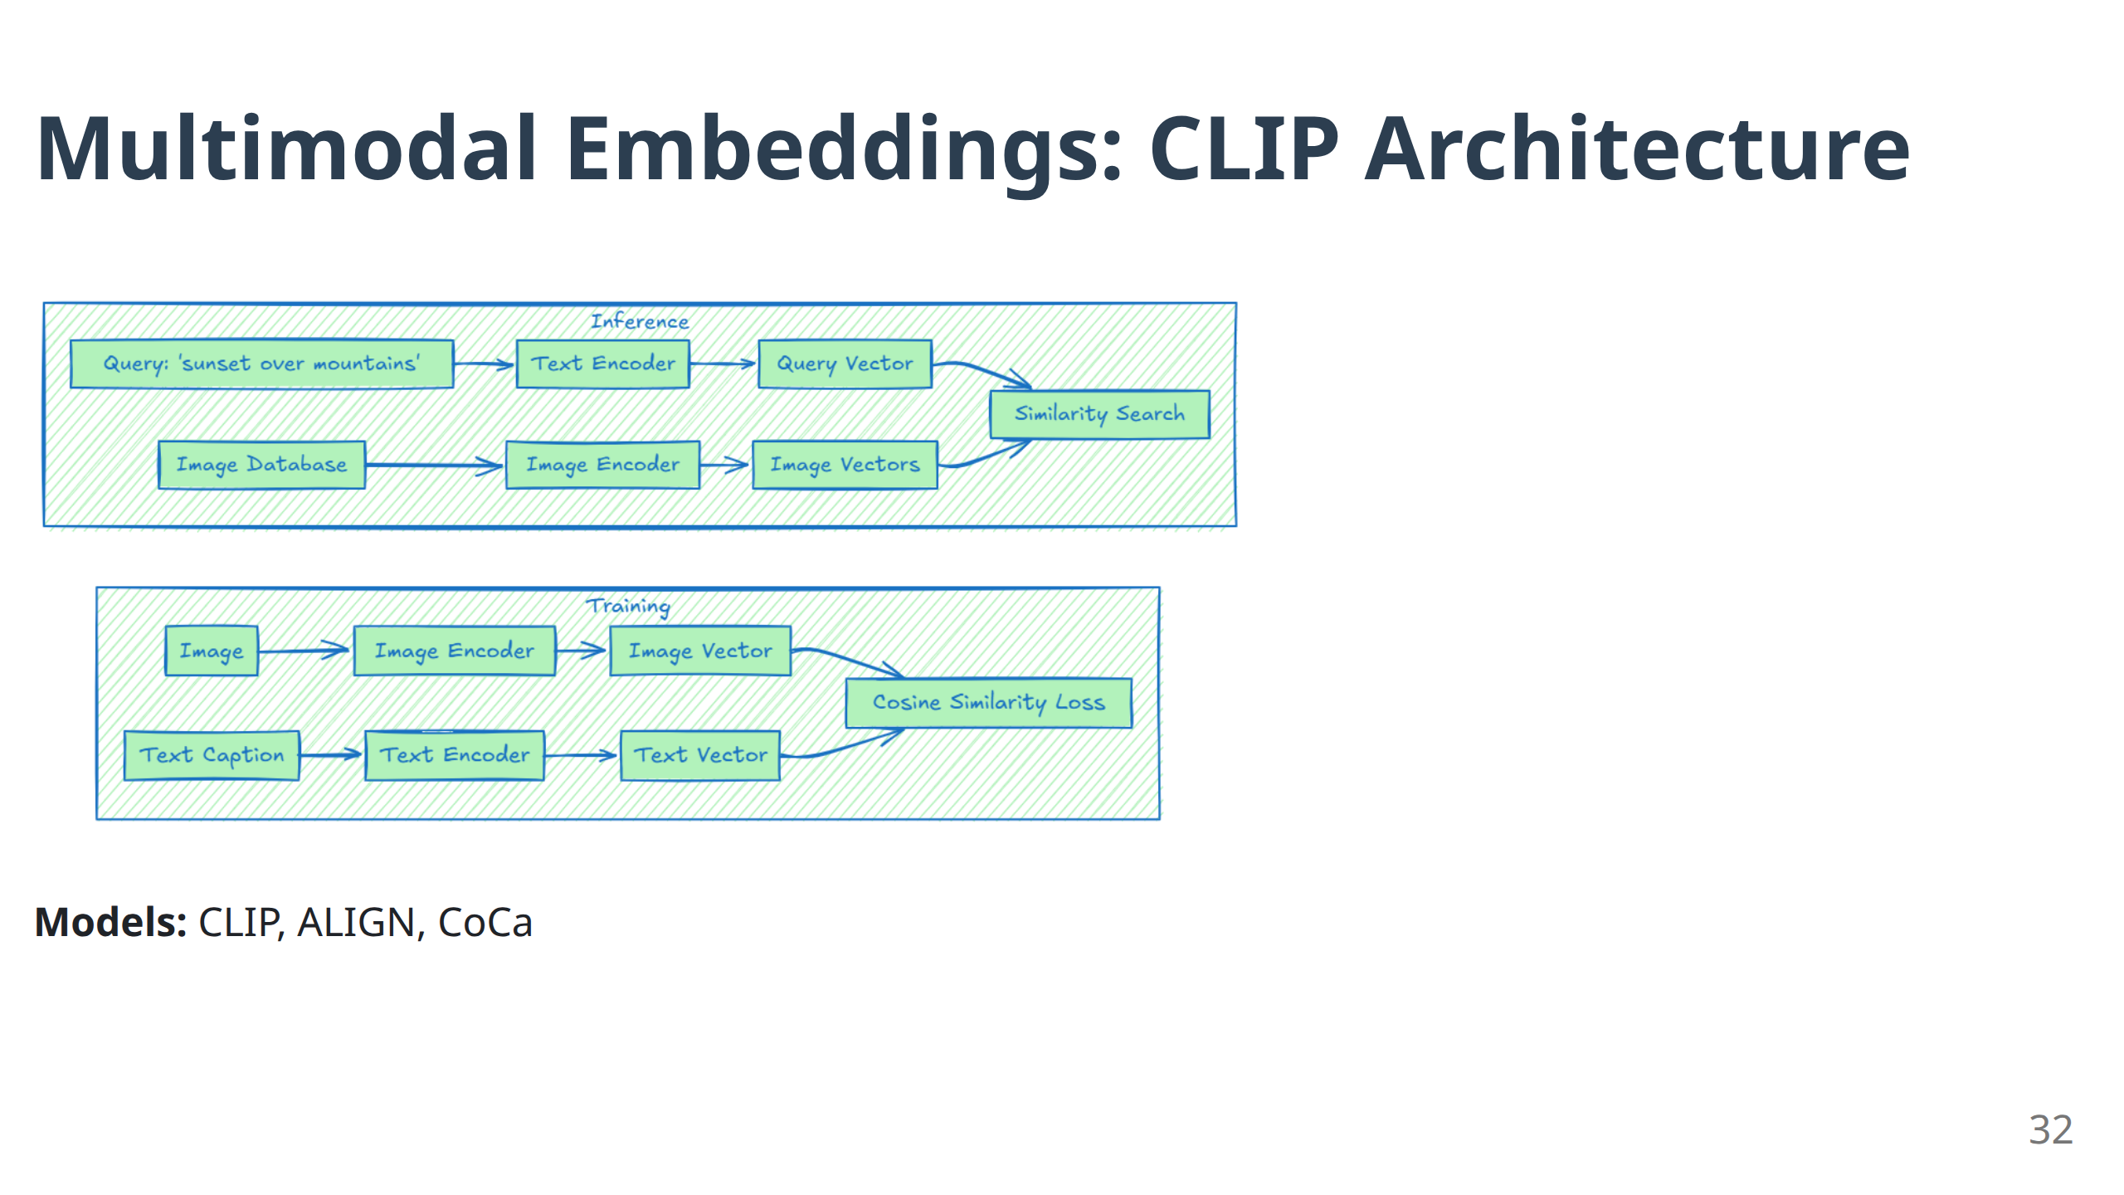
Notes:
- **Revolutionary Concept:** "CLIP was trained to understand that an image of a sunset and the text 'beautiful sunset' should have similar embeddings."
- **Shared Space Magic:** "Images and text live in the same vector space. You can search for images using text queries."
- **Training Insight:** "The contrastive learning forces related image-text pairs to be close, unrelated pairs to be far apart."
- **Practical Application:** "Now you can ask 'show me charts about quarterly revenue' and get actual chart images, not just text descriptions."

Slide 33
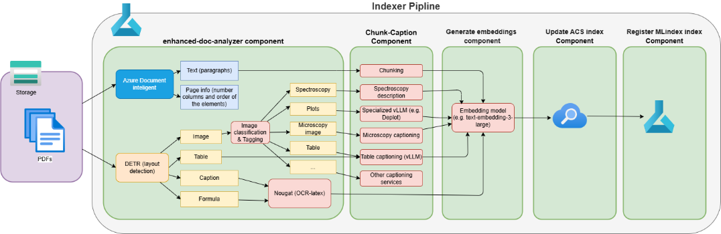
A real-life example:
Applicability of specialized GenAI models:
Layout detection (Meta’s DETR-based Aryn/deformable-detr-DocLayNet, trained on DocLayNet (including 80K annotated scientific article pages))
OCR and LaTeX formula extraction from documents (Meta’s Nougat)
Image captioning per image category:
Converting the plot images to linearized tables (DePlot) for improved visual language reasoning
Domain adapted LLM e.g. ChemVLM for Chemical molecules and reactions
Additional fine-tuning

Slide 34
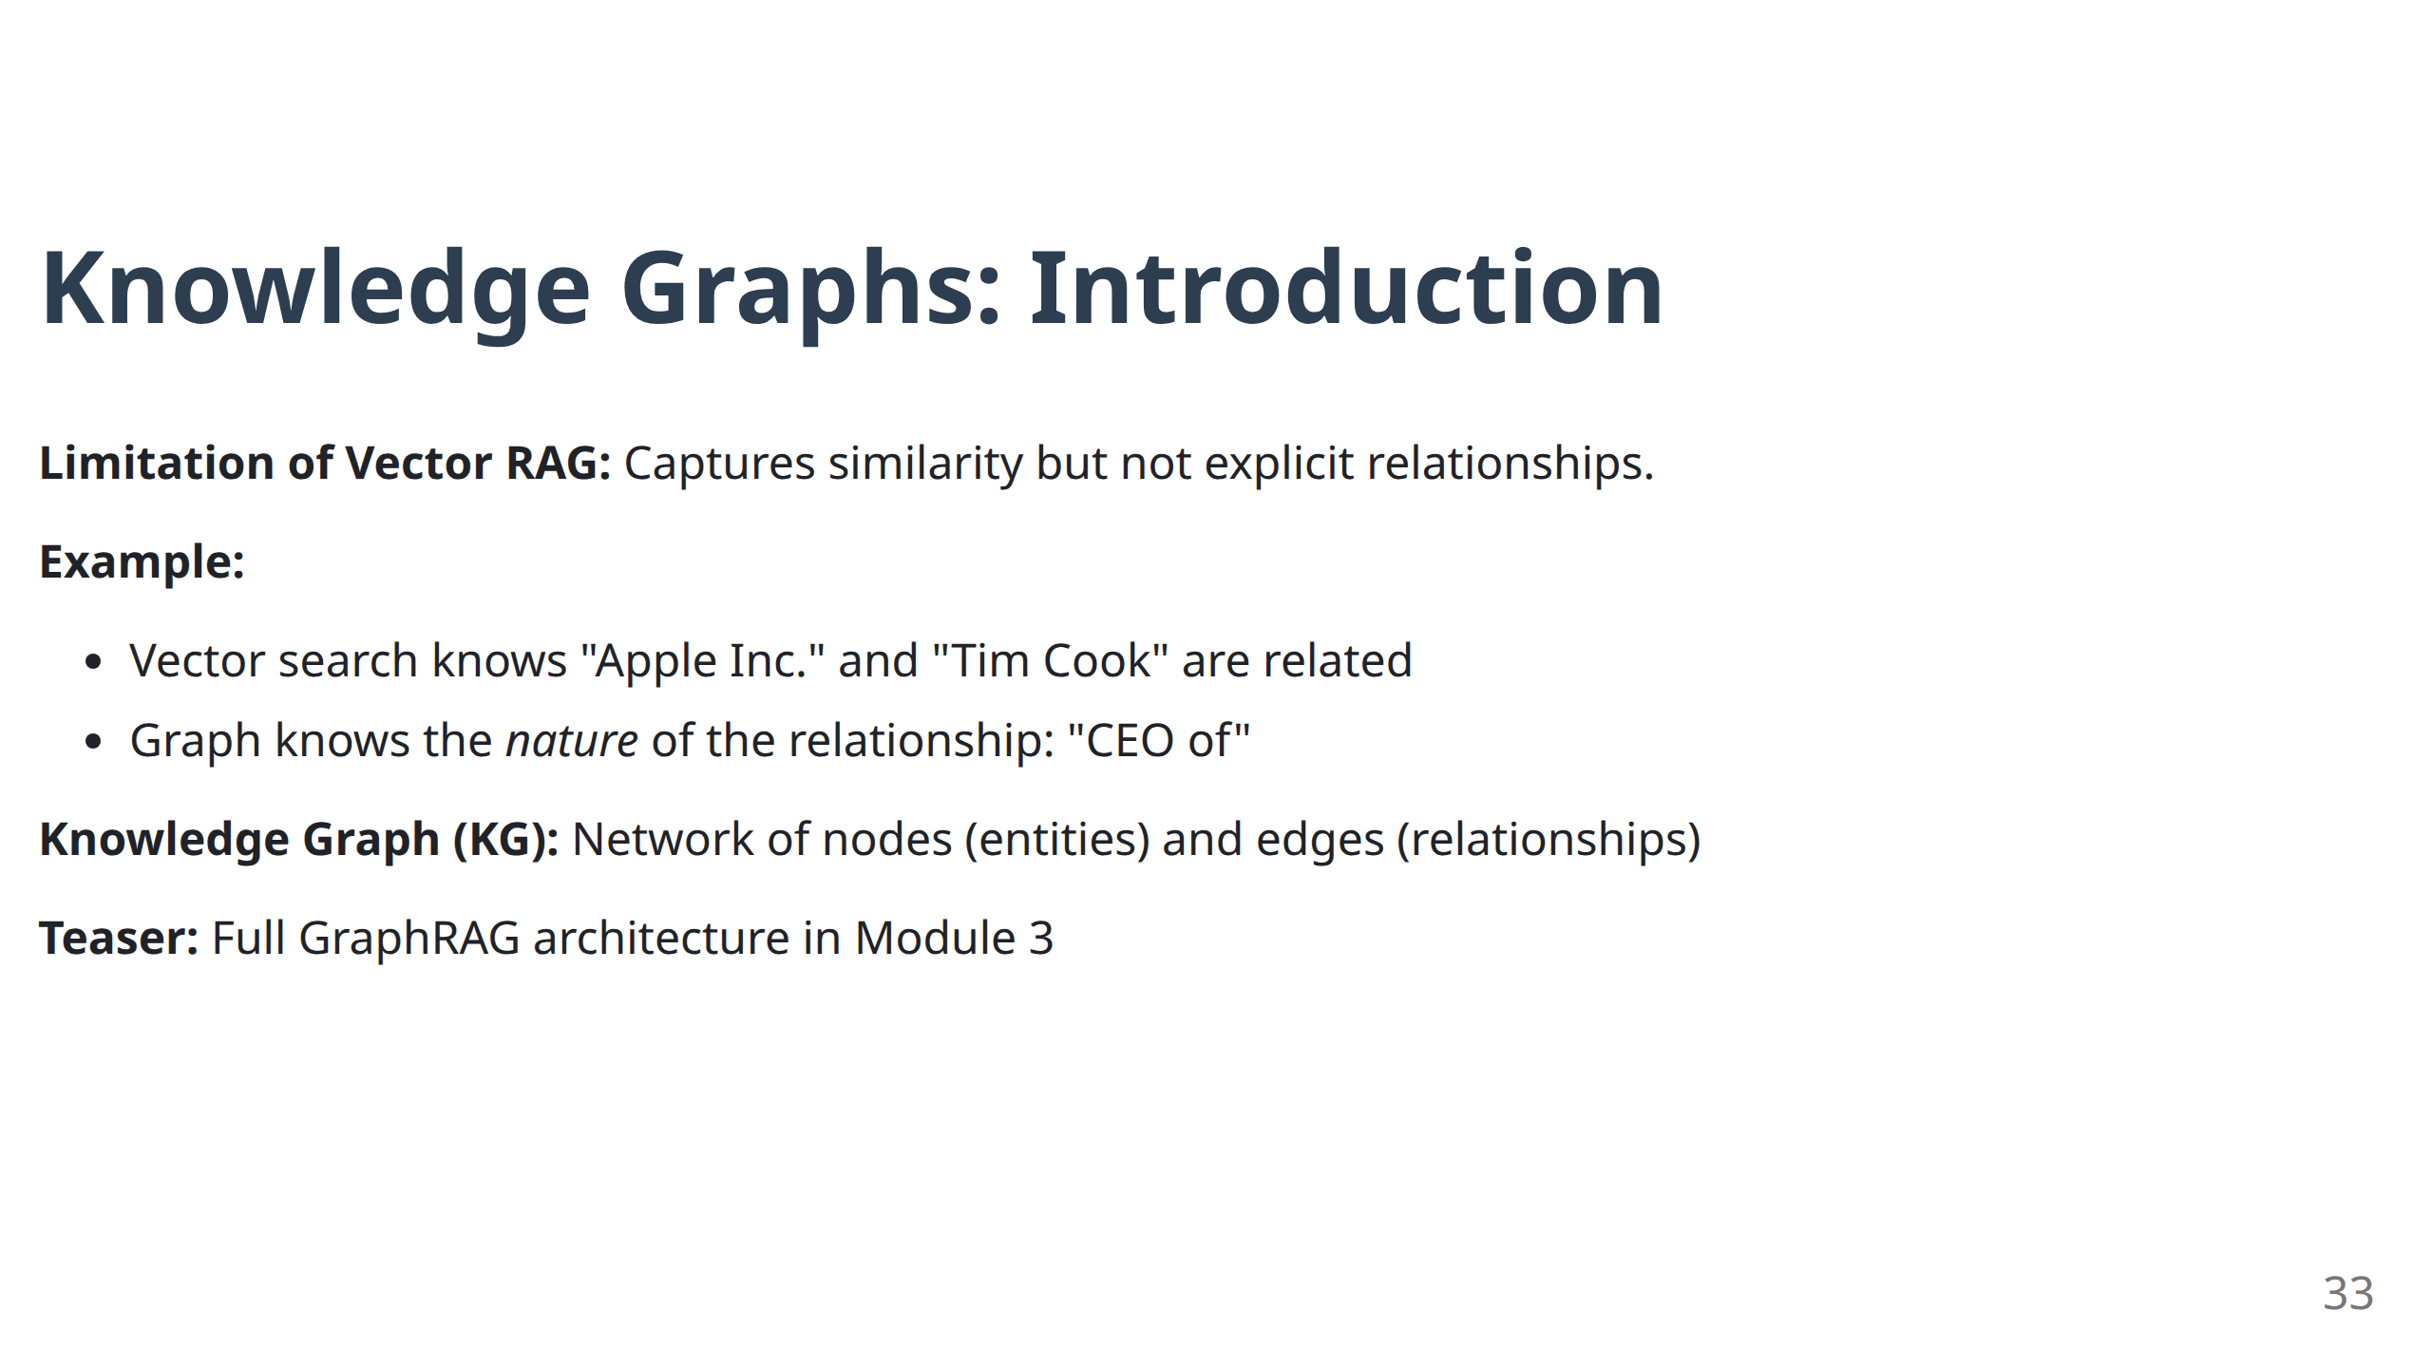
Notes:
- **Fundamental Limitation:** "Vector search is amazing at similarity but terrible at relationships."
- **Explicit vs Implicit:** "Vectors capture implicit relationships. Graphs capture explicit, structured relationships."
- **Example Power:** "A vector might know Apple and Tim Cook are related, but a graph knows Tim Cook is the CEO of Apple, started in 2011, replaced Steve Jobs."
- **Teaser Effective:** "We'll see in Module 3 how this enables entirely new types of reasoning."

Slide 35
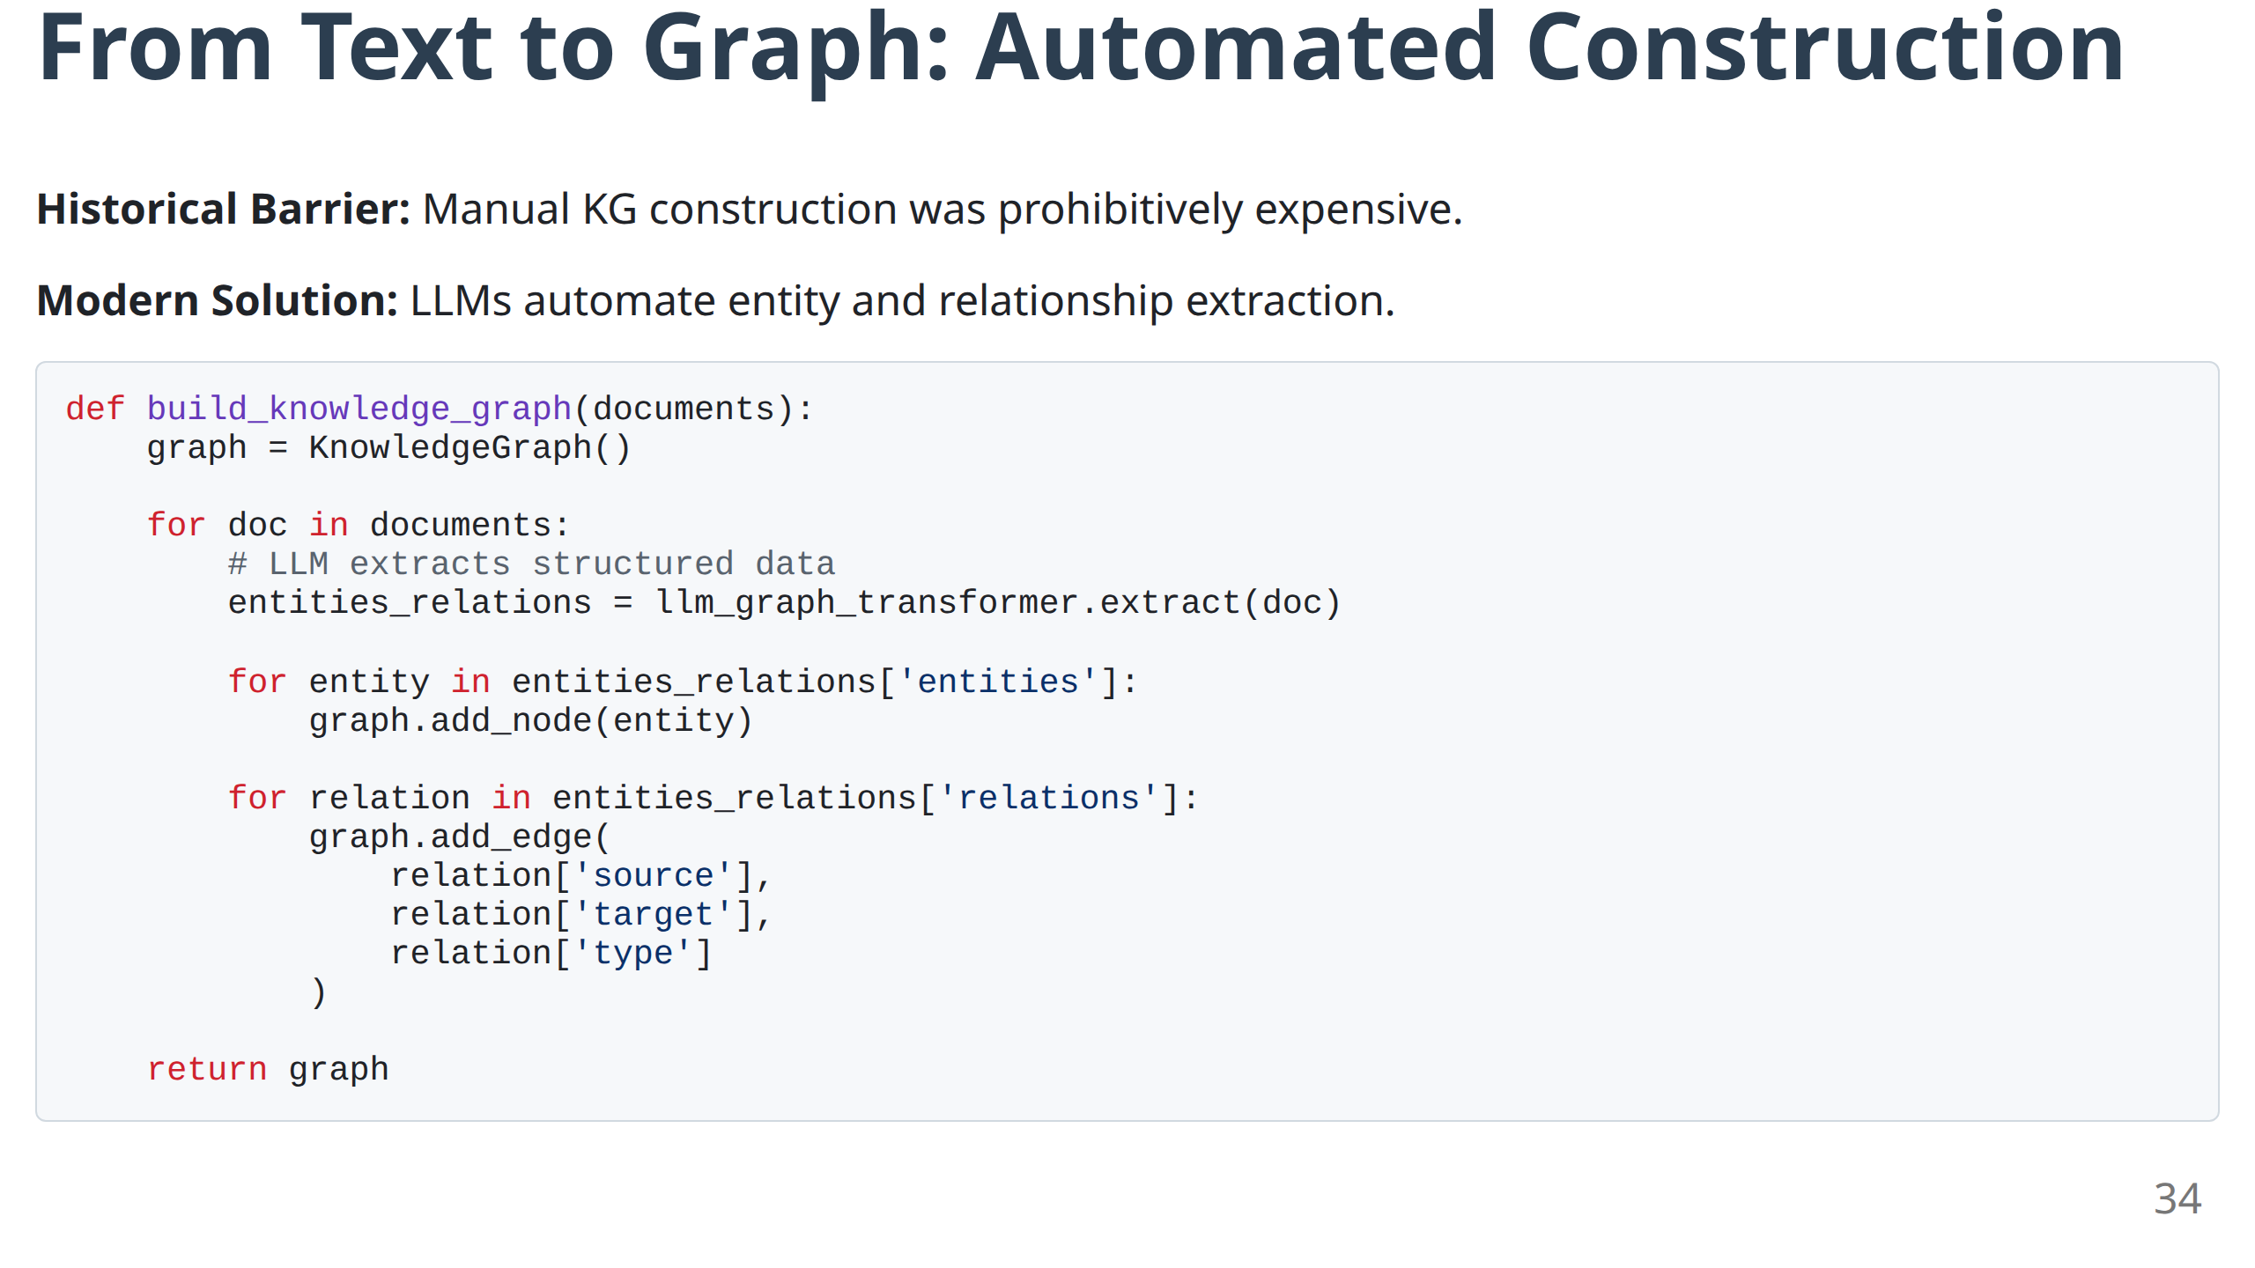
Notes:
- **Historical Context:** "Knowledge graphs used to require teams of knowledge engineers working for months or years."
- **Modern Revolution:** "LLMs can extract entities and relationships automatically. This changes everything."
- **Virtuous Cycle:** "Text → LLM → Graph → GraphRAG → Better answers. The LLM helps build the system that makes LLMs better."
- **Code Insight:** "The key is the LLM_graph_transformer - this is where the magic happens."

Slide 36
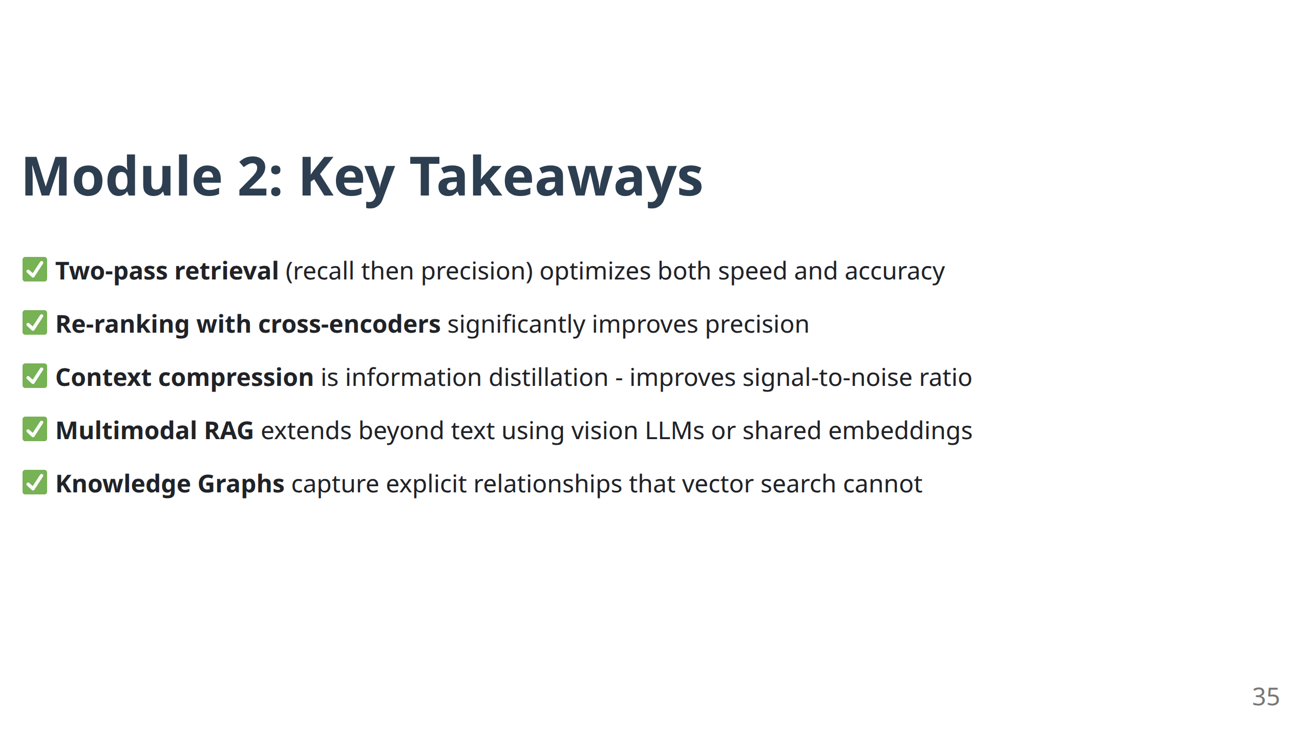
Notes:
- **Production Readiness:** "These techniques are the difference between a demo and a production system."
- **Optimization Stack:** "Two-pass retrieval, re-ranking, compression - these stack together multiplicatively."
- **Multimodal Reality:** "Real-world data is multimodal. Your RAG system should be too."
- **Graph Preview:** "Knowledge graphs unlock new reasoning capabilities we'll explore after the break."
- **Break Transition:** "Perfect time for a break. When we return, we'll see how graphs enable multi-hop reasoning and self-correcting systems."

Slide 37

Coffee Break
15 Minutes
Notes:
- **Midpoint Check:** "We've covered the foundations and optimizations. After the break, we move to truly advanced architectures."
- **Mindset Reset:** "The second half is about systems that can reason, plan, and self-correct. These aren't just better RAG systems - they're different kinds of systems."
- **Networking Encouragement:** "Great time to discuss what you've learned so far with others."

Slide 38
Module 3
Advanced Architectures I: GraphRAG & Self-Correcting RAG
Notes:
- **Paradigm Shift Announcement:** "We're moving from retrieval systems to reasoning systems."
- **Cognitive Architecture:** "These systems don't just find information - they reason about relationships and evaluate their own thinking."

Slide 39
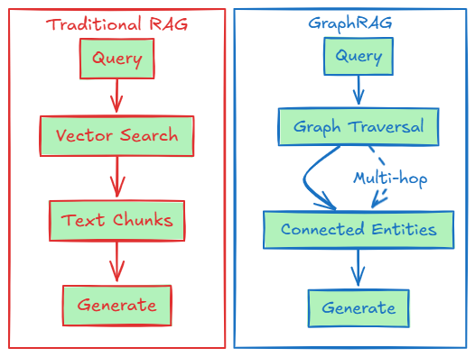
GraphRAG: Merging Connectionist & Symbolic AI
Paradigm Shift: From unstructured text retrieval to structured relationship reasoning
Key Capability: Multi-hop reasoning across explicit relationships
38
Notes:
- **Historical Context:** "This represents the reunion of two AI traditions - neural networks (connectionist) and knowledge graphs (symbolic)."
- **Multi-hop Reasoning:** "Traditional RAG is like having perfect memory but no ability to connect the dots. GraphRAG connects the dots."
- **Diagram Emphasis:** "Notice the 'Multi-hop' annotation - this is the key capability difference."

Slide 40
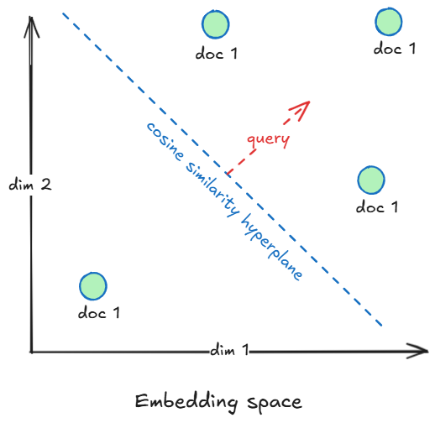
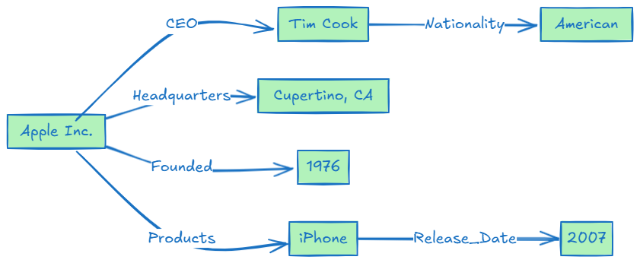
Knowledge Graph Structure
Components:
Nodes: Entities (people, places, concepts, products)
Edges: Relationships (works_for, located_in, caused_by)
Properties: Attributes (name, date, description)
Query Example: "What products are made by the company Tim Cook leads?"
Multi-hop: Tim Cook → CEO → Apple Inc. → Products → iPhone
39
Notes:
- **Simple but Powerful:** "The structure is simple - nodes and edges - but the reasoning capability is profound."
- **Real Example Walkthrough:** "Let's trace the multi-hop query: 'What products are made by the company Tim Cook leads?'"
- **Step 1:** "Find Tim Cook → CEO relationship → Apple Inc."
- **Step 2:** "Find Apple Inc. → Products relationship → iPhone"
- **Human Analogy:** "This is how humans naturally think - we follow chains of reasoning."

Slide 41
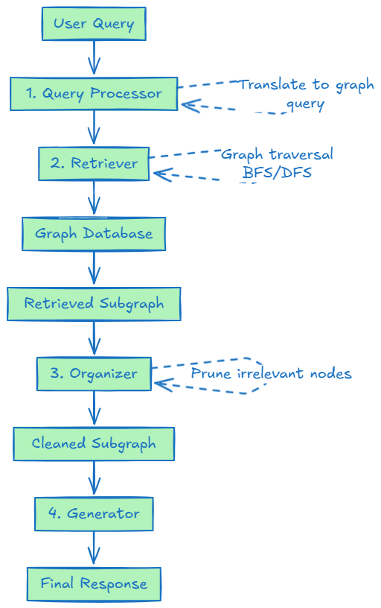
GraphRAG Architecture: Four Components
40
Notes:
- **System Design:** "Each component has a specific role. This isn't a pipeline - it's an architecture."
- **Query Processor:** "Translates human language to graph language."
- **Retriever:** "Navigates the graph to find connected information."
- **Organizer:** "Cleans and focuses the retrieved subgraph."
- **Generator:** "Synthesizes the structured information into natural language."

Slide 42
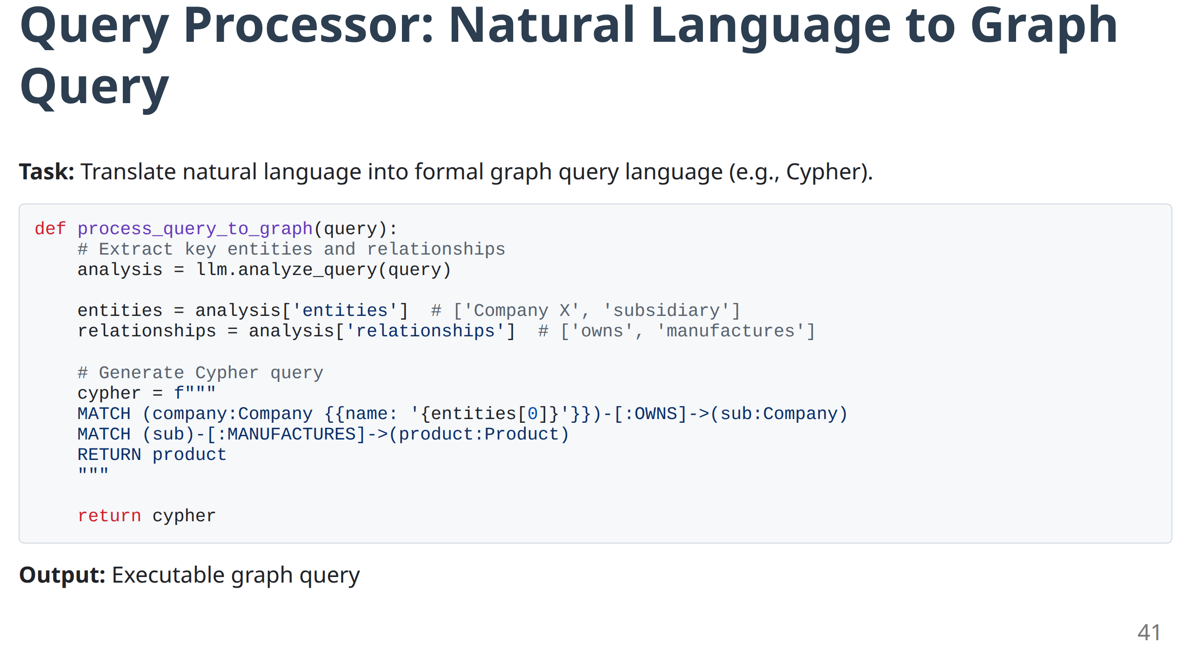
Notes:
- **Translation Challenge:** "Converting 'Who works for companies that compete with Apple?' into a graph query is non-trivial."
- **LLM Role:** "The LLM analyzes the query structure and identifies the entities and relationships needed."
- **Cypher Example:** "Walk through the generated Cypher query to show the translation in action."
- **Error Handling:** "In production, this step often requires multiple attempts and validation."

Slide 43
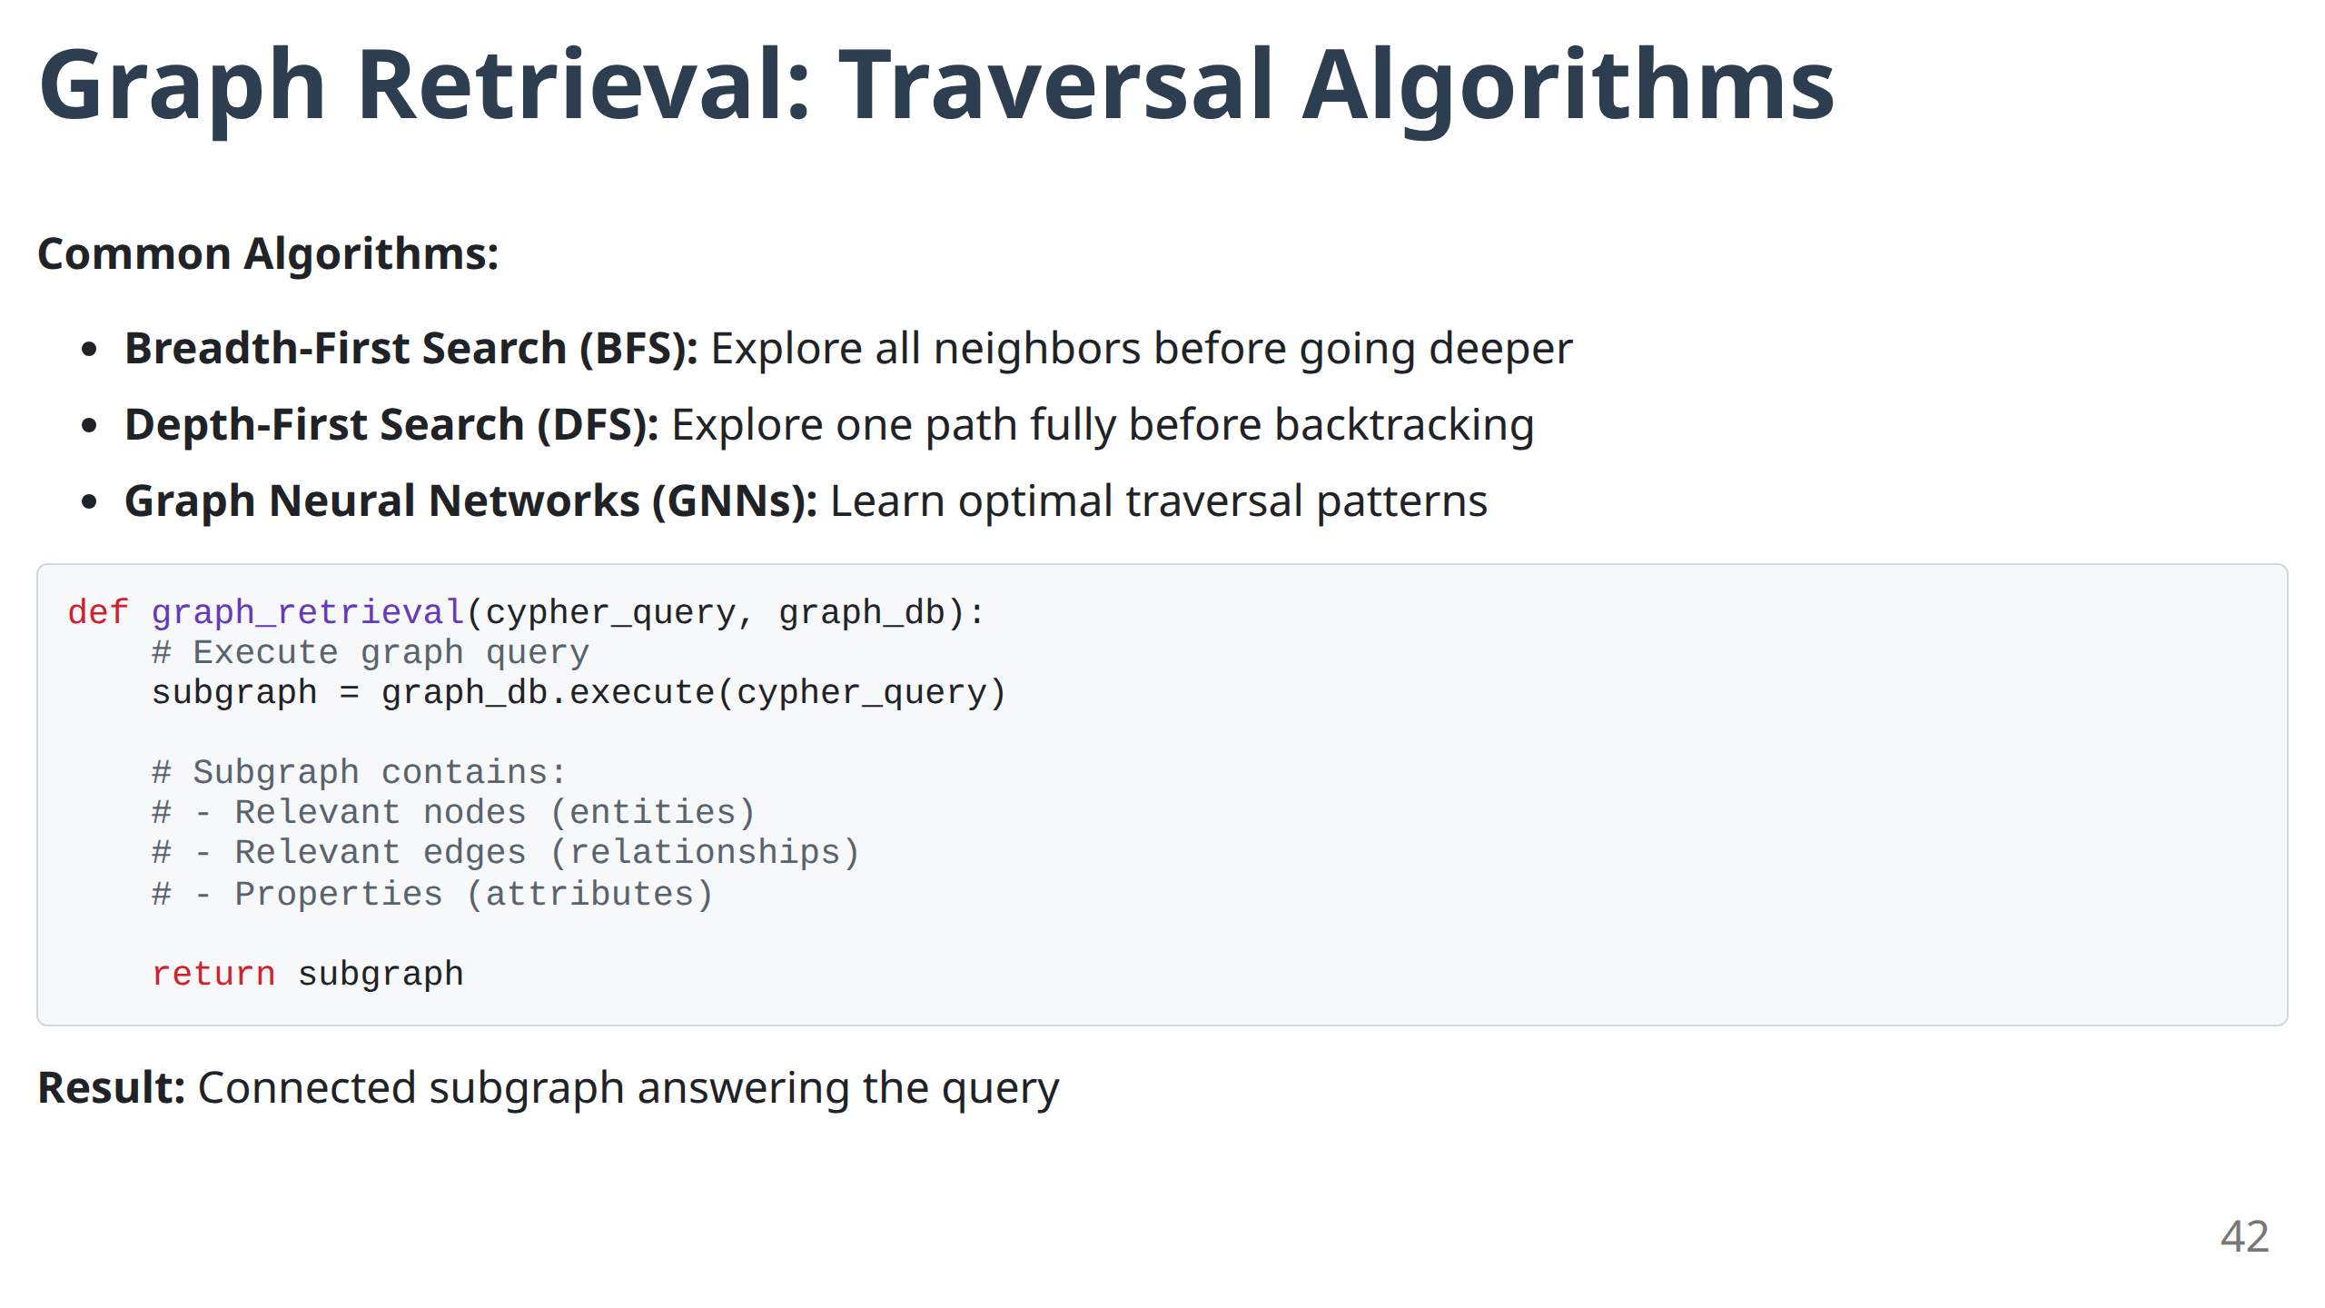
Notes:
- **Algorithm Choice Matters:** "BFS vs DFS vs GNNs aren't just academic choices - they produce different results."
- **BFS:** "Good for finding all connections within a certain distance."
- **DFS:** "Good for following specific relationship chains deeply."
- **GNNs:** "Can learn optimal traversal patterns from data."
- **Production Tip:** "Start with BFS for most use cases."

Slide 44
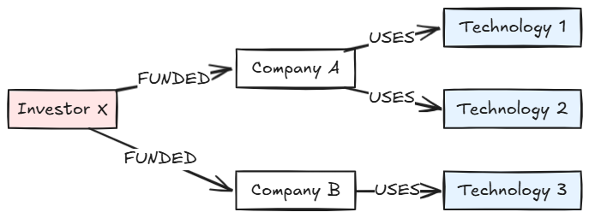
Multi-Hop Reasoning Example
Query: "What technologies are used by companies funded by Investor X?"
Hop 1: Investor X → Companies (A, B)
Hop 2: Companies → Technologies (1, 2, 3)
Answer: Technology 1, Technology 2, Technology 3
43
Notes:
- **Concrete Demonstration:** "This example shows why GraphRAG is powerful - traditional RAG would need the exact question to be answered somewhere in the text."
- **Hop-by-Hop:** "Walk through each hop to show how the reasoning builds."
- **Scalability:** "This works for 2 hops, 3 hops, or more. The graph handles arbitrary complexity."
- **Business Value:** "These kinds of insights are what knowledge workers do manually. Now it's automated."

Slide 45
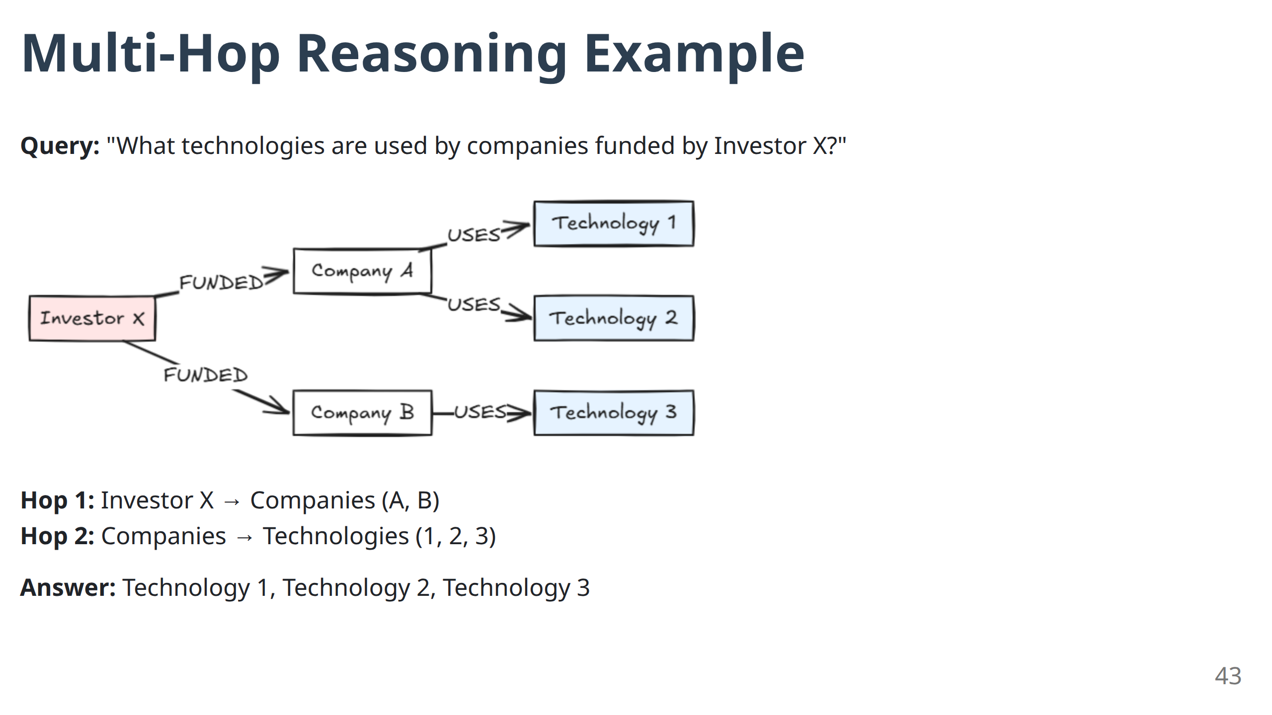
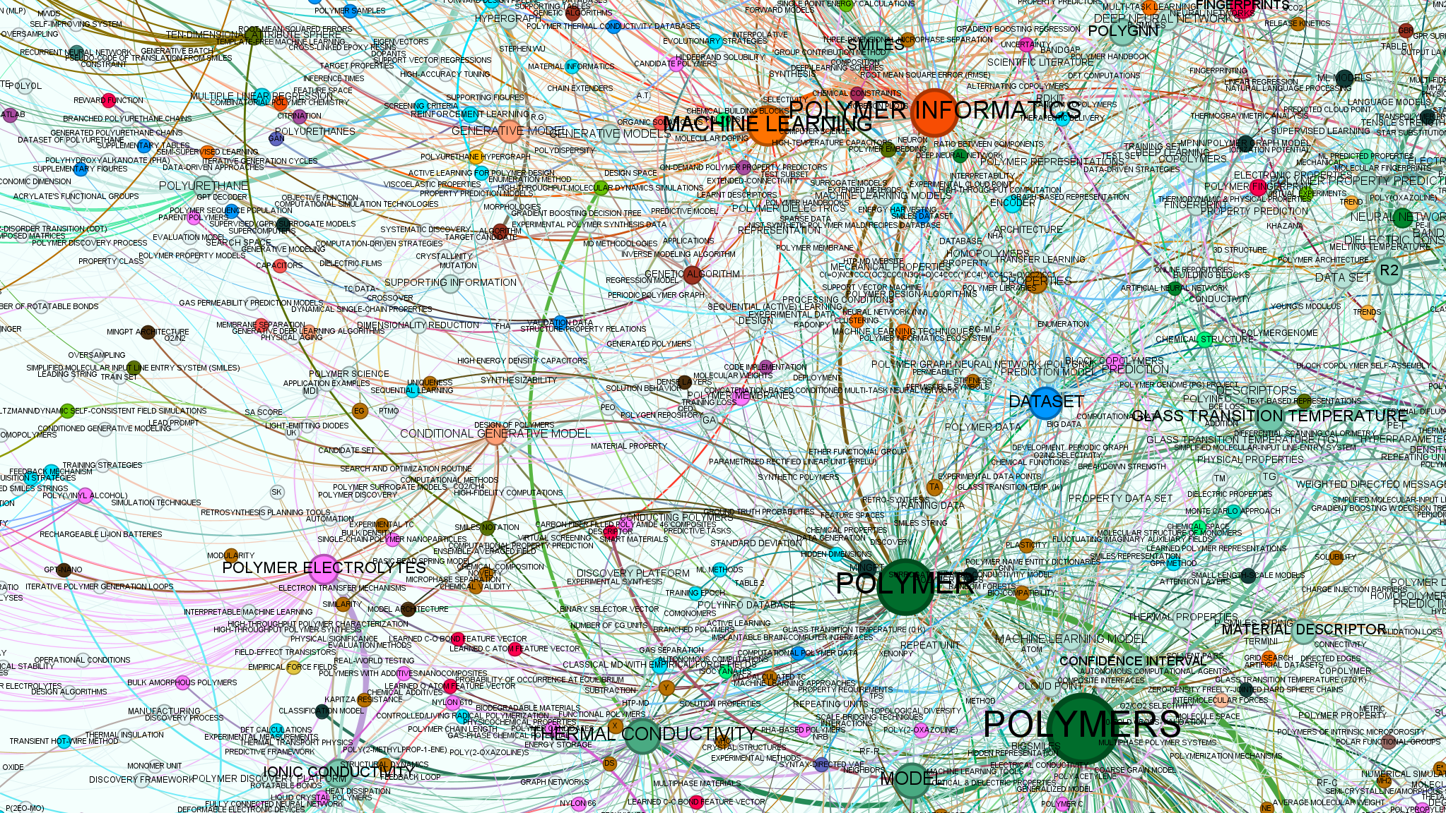

Slide 46
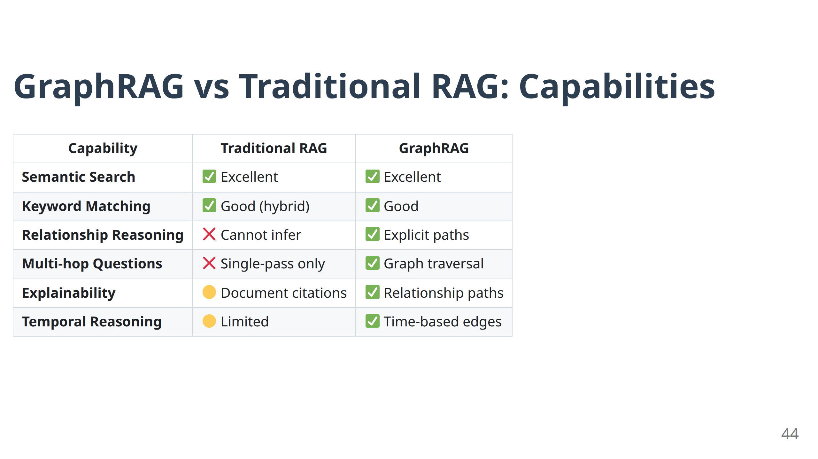
Notes:
- **Capability Comparison:** "This table shows why GraphRAG isn't just an improvement - it's a different class of system."
- **Relationship Reasoning:** "The key differentiator. Traditional RAG cannot infer relationships."
- **Explainability:** "Graph paths provide natural explanations for how the answer was derived."
- **Trade-offs:** "GraphRAG is more complex to build and maintain, but enables capabilities that are impossible with traditional RAG."

Slide 47
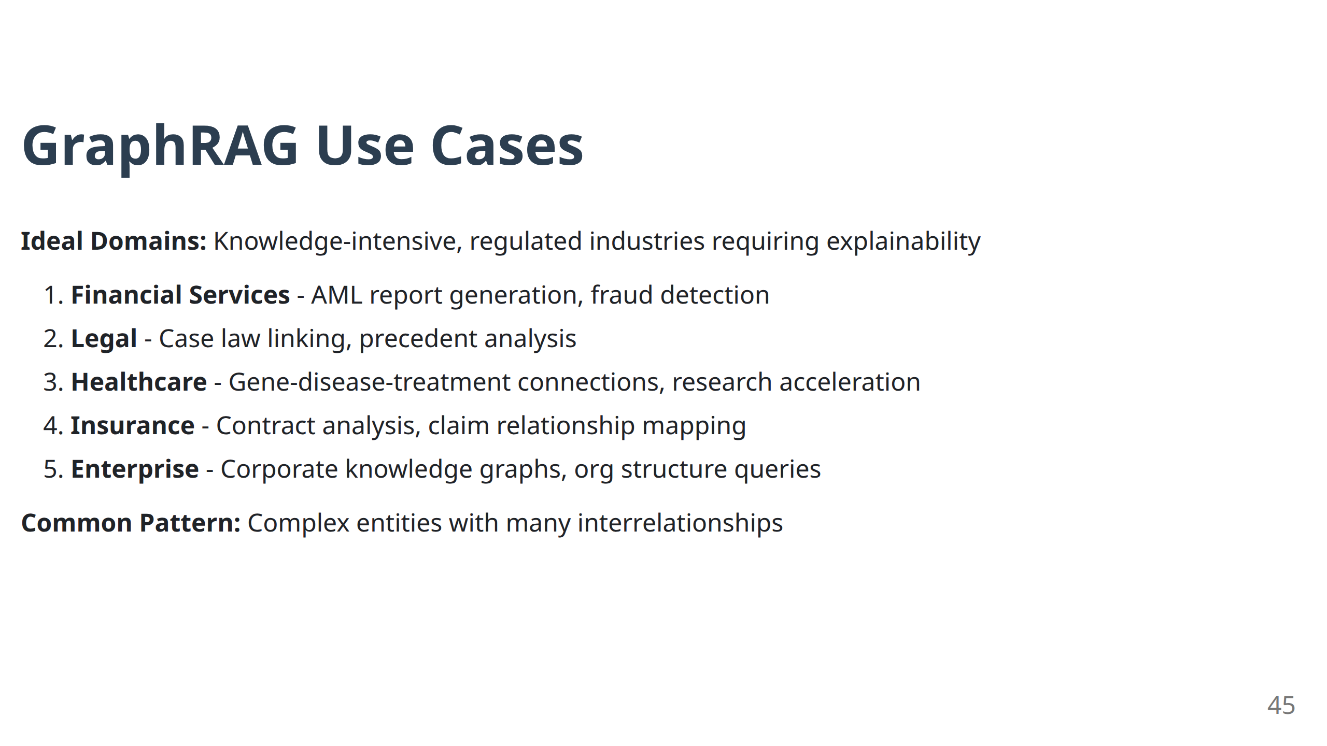
Notes:
- **Domain Patterns:** "Notice these are all knowledge-intensive domains where relationships matter."
- **Regulatory Requirement:** "In finance and legal, explainability isn't nice-to-have - it's required."
- **Network Effects:** "The more connected your data, the more valuable GraphRAG becomes."
- **Implementation Reality:** "Start with a focused use case, then expand the graph over time."

Slide 48
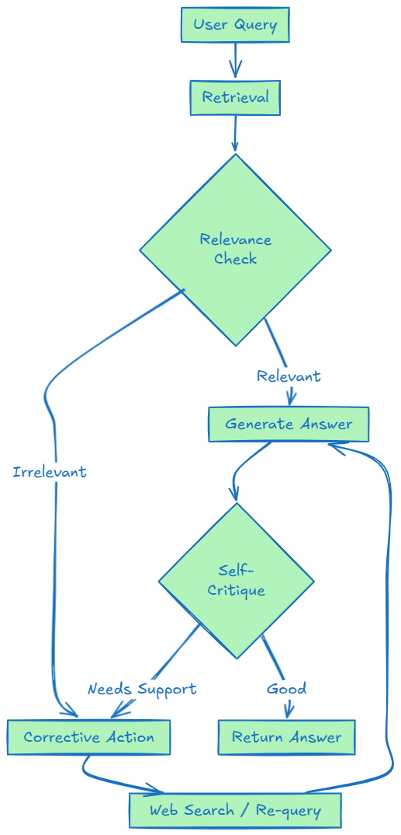
Self-Correcting RAG: The Reflection Pattern
Limitation of Basic RAG:
No quality control - bad retrieval = bad answer
Solution: Add self-evaluation and corrective loops
Key Patterns: Self-RAG, Corrective RAG (CRAG)
46
Notes:
- **Quality Control:** "Basic RAG has no quality control. It blindly trusts whatever gets retrieved."
- **Human-Like Behavior:** "Humans check their work. Self-correcting RAG does too."
- **Feedback Loop:** "The key insight is the feedback loop - the system can retry and improve."
- **Production Impact:** "This dramatically improves reliability in production systems."

Slide 49
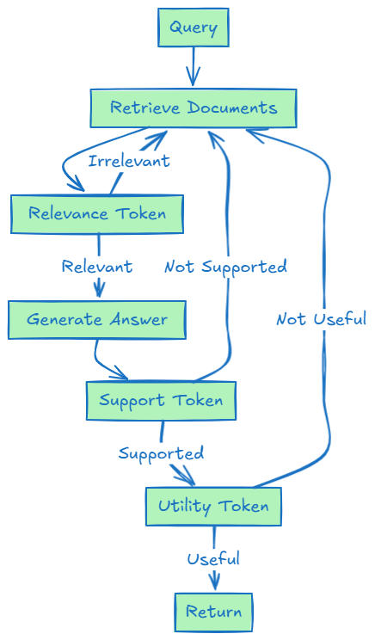
Self-RAG Architecture
Innovation: LLM generates "reflection tokens" to self-assess at each step.
Reflection Tokens:
Relevance: Is the document relevant to the query?
Support: Is the answer supported by the document?
Utility: Is the answer useful to the user?
47
Notes:
- **Reflection Tokens:** "These are special tokens the LLM generates to evaluate its own performance."
- **Self-Assessment:** "At each step, the system asks: 'Am I doing well?'"
- **Token Types:** "Relevance (input quality), Support (output grounding), Utility (user value)."
- **Iterative Improvement:** "Each token can trigger corrective action."

Slide 50
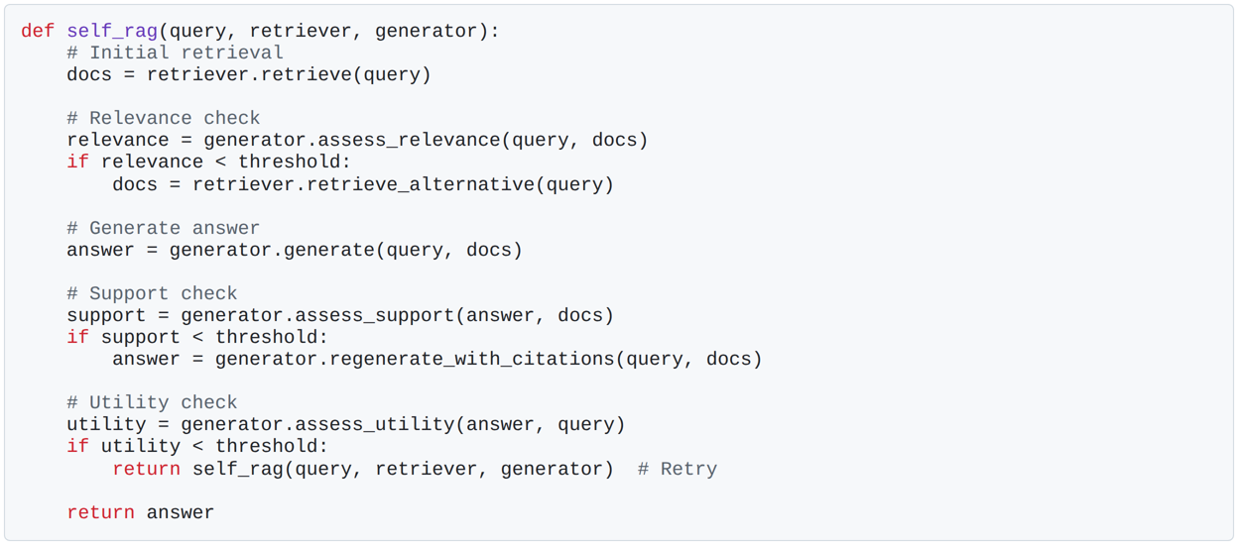
Self-RAG: Reflection Token Generation
48
Notes:
- **Code Walkthrough:** "This shows the implementation pattern - check, improve, repeat."
- **Threshold Tuning:** "These thresholds determine how strict the self-assessment is."
- **Failure Recovery:** "Notice how each check can trigger different recovery strategies."
- **Production Consideration:** "This increases latency but dramatically improves quality."

Slide 51
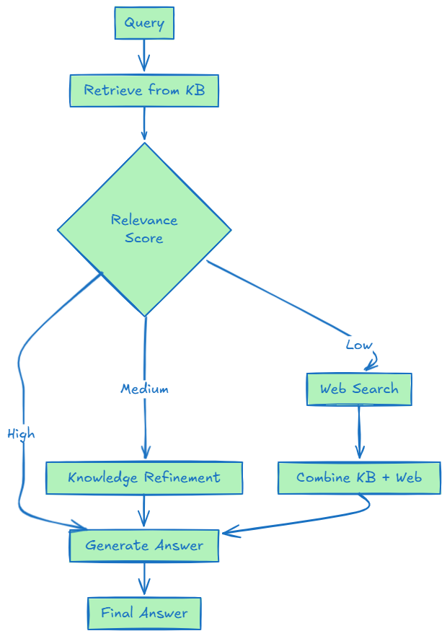
Corrective RAG (CRAG): External Fallback
Innovation: Detect poor retrieval and trigger web search as fallback.
Threshold-Based Routing:
High confidence: Use internal KB
Medium confidence: Refine/decompress KB results
Low confidence: Fallback to web search
49
Notes:
- **Confidence-Based Routing:** "Different confidence levels trigger different strategies."
- **Web Search Fallback:** "When internal knowledge is insufficient, the system automatically searches external sources."
- **Knowledge Refinement:** "The middle path - improve what you have rather than replacing it."
- **Hybrid Approach:** "Combines internal and external knowledge sources intelligently."

Slide 52
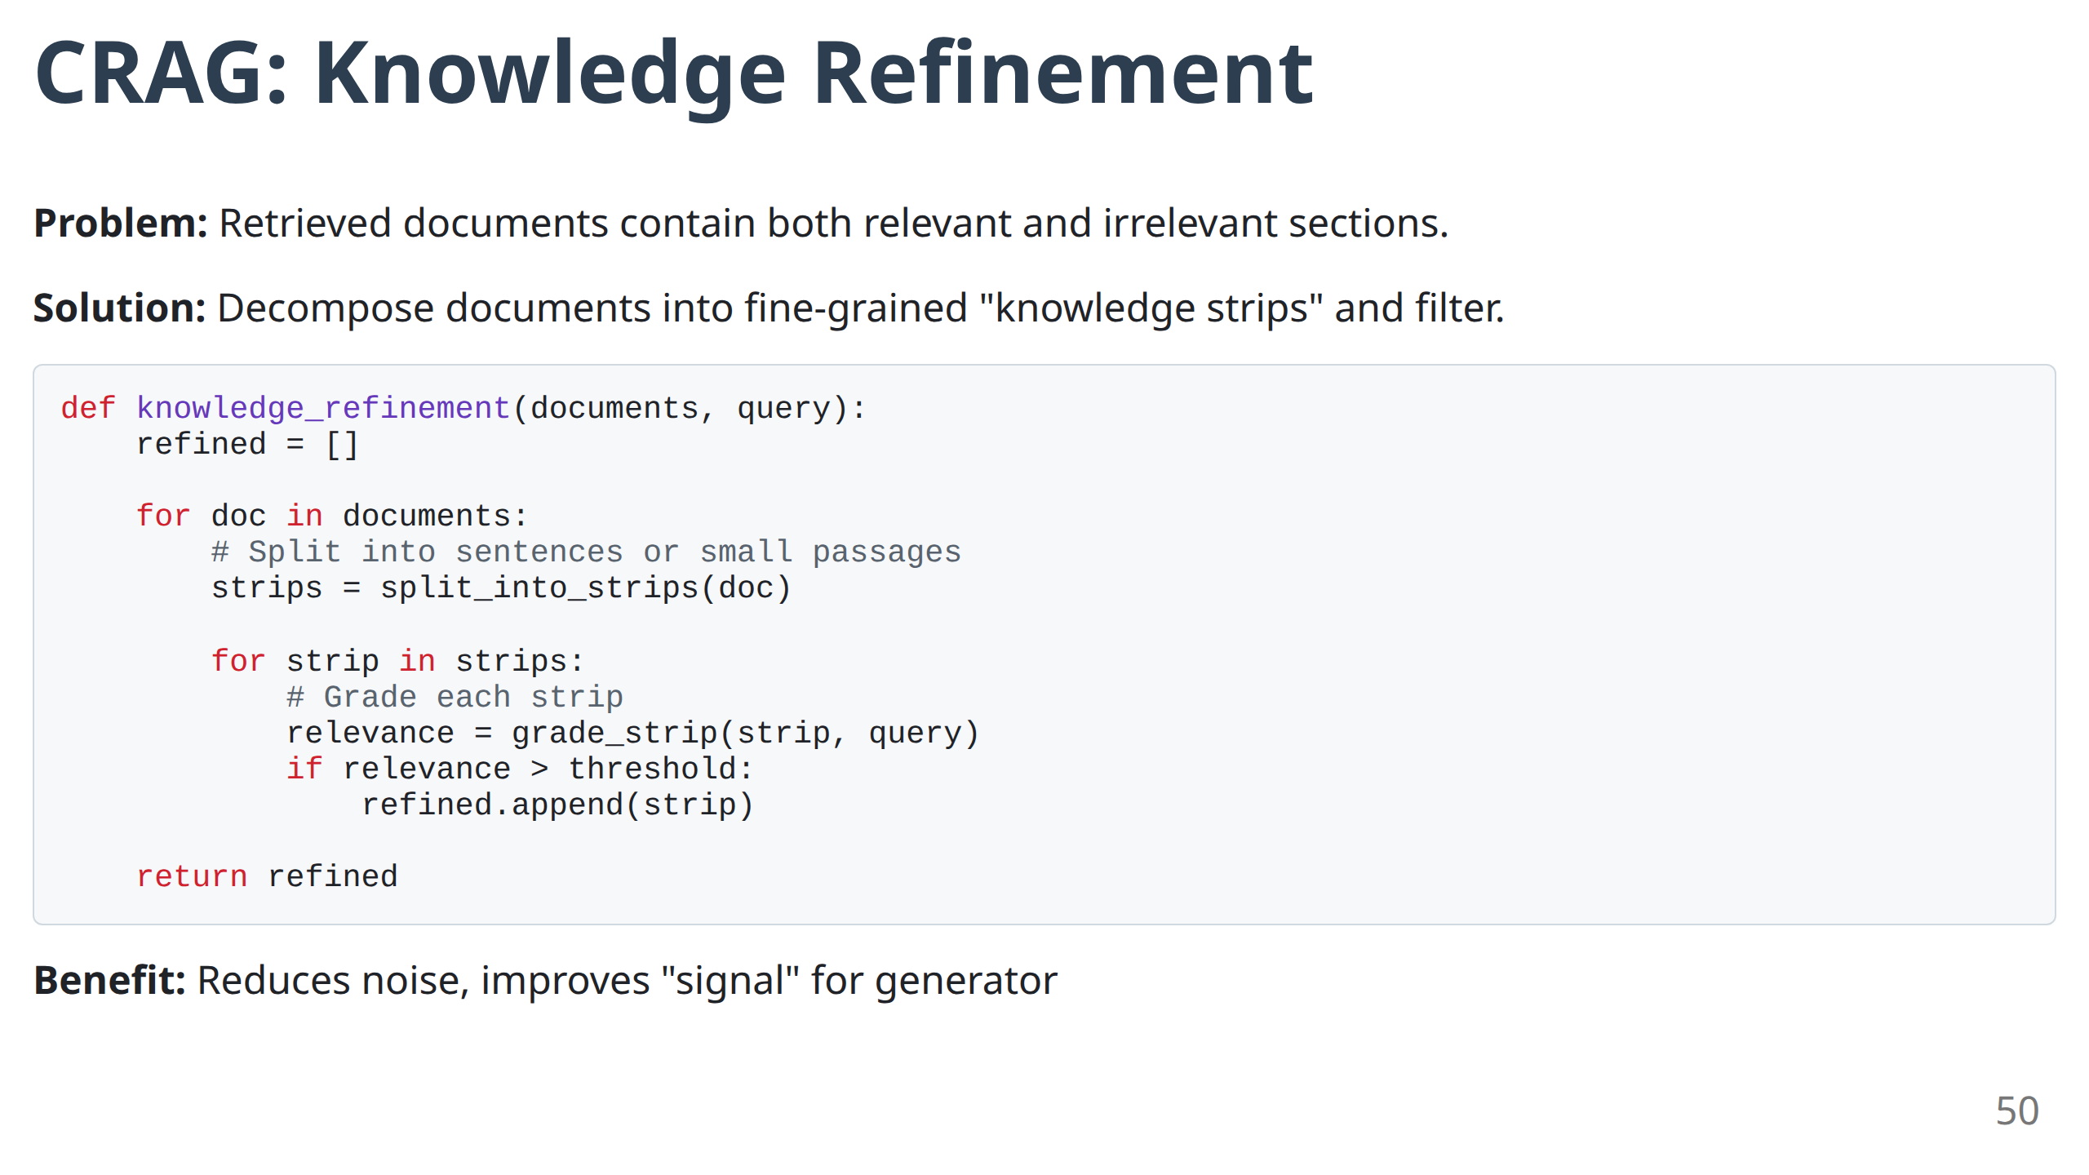
Notes:
- **Granular Processing:** "Instead of all-or-nothing, this works at the sentence level."
- **Noise Reduction:** "Removes irrelevant parts of relevant documents."
- **Signal Enhancement:** "Concentrates the useful information for the generator."
- **Implementation Tip:** "The grade_strip function can be a simple relevance classifier."

Slide 53
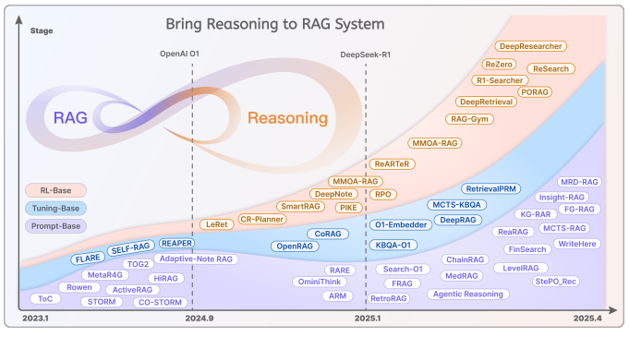
RAG-reasoning
Source: https://arxiv.org/pdf/2504.15909
51

Slide 54
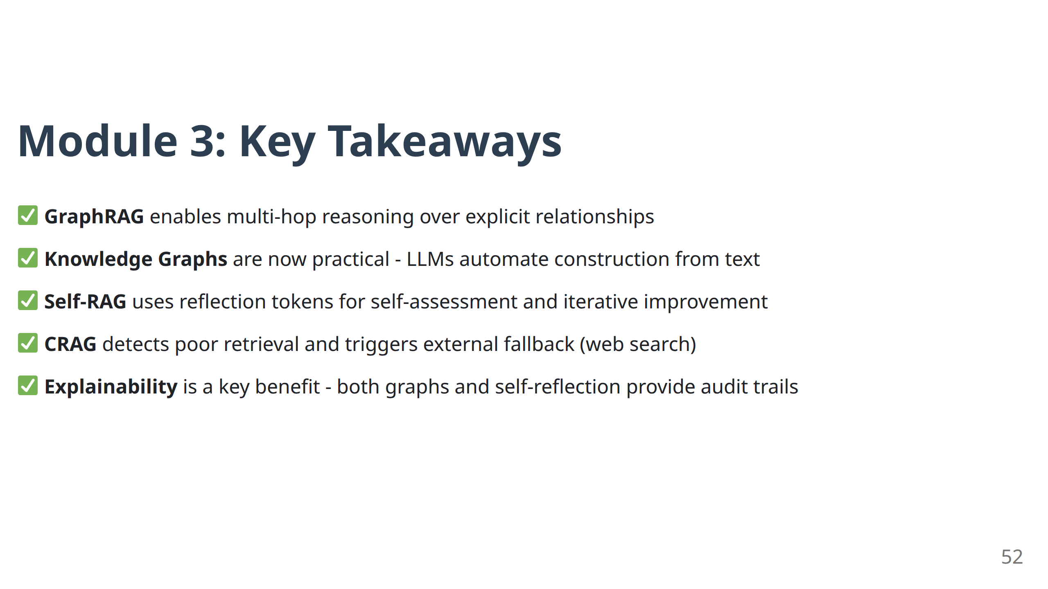
Notes:
- **Reasoning Capability:** "We've moved from retrieval to reasoning. These systems can follow chains of logic."
- **Self-Improvement:** "Self-correcting systems can evaluate and improve their own performance."
- **Explainability:** "Both GraphRAG and self-reflection provide transparency into the reasoning process."
- **Production Ready:** "These aren't research prototypes - they're production-ready architectures."
- **Transition:** "Module 4 takes this even further - systems that can plan, use tools, and conduct research autonomously."

Slide 55
Module 4
Advanced Architectures II: Agentic & Deep Research RAG
Notes:
- **Biggest Paradigm Shift:** "This is the biggest conceptual leap we'll make today. We're moving from static pipelines to autonomous agents."
- **LLM Role Evolution:** "The LLM transforms from a text generator to an orchestrator and decision-maker."

Slide 56

Notes:
- **Static vs Dynamic:** "Traditional RAG follows a script. Agentic RAG writes its own script based on the task."
- **Orchestrator Role:** "The LLM becomes the conductor of an orchestra of tools and data sources."
- **Flexibility:** "Agents can adapt their strategy based on what they find, just like human researchers do."

Slide 57

What is an AI Agent?
Definition: An LLM-powered system that can:
Plan - Decompose complex tasks into steps
Act - Execute actions using tools (APIs, search, code)
Observe - Examine results of actions
Reason - Decide next action based on observations
Remember - Maintain context across interactions
55
Notes:
- **Five Core Capabilities:** "These capabilities working together create emergent intelligence."
- **Plan:** "Break down complex tasks into manageable steps."
- **Act:** "Execute actions using available tools."
- **Observe:** "Examine and understand the results."
- **Reason:** "Make decisions based on observations."
- **Remember:** "Maintain context across multiple interactions."
- **Control Loop:** "This is a classic control loop from systems engineering, applied to AI."

Slide 58

The ReAct Pattern: Reason + Act
Core Idea: Interleave reasoning traces with action execution.
56
Notes:
- **Interleaving Power:** "The magic is in the interleaving - reason, act, observe, repeat."
- **Human-Like Behavior:** "This mirrors how humans solve complex problems - we don't plan everything upfront."
- **Code Structure:** "The loop structure is simple but powerful - it can handle arbitrarily complex tasks."
- **Termination:** "Notice the should_finish check - agents need to know when they're done."

Slide 59

Notes:
- **Concrete Demonstration:** "This example shows the agent's thought process in action."
- **Tool Selection:** "Notice how the agent chooses different tools for different information needs."
- **Chain of Reasoning:** "Each step builds on the previous, creating a logical chain."
- **Dynamic Strategy:** "The agent adapts its approach based on what it finds."

Slide 60

Agentic RAG Patterns: Routing
Problem: Enterprise data is fragmented across multiple sources.
Solution: Routing agent dispatches query to appropriate data source(s).
58
Notes:
- **Enterprise Reality:** "Most enterprise data is fragmented. Agents can navigate this complexity."
- **Intelligent Dispatch:** "The routing agent acts like a smart librarian, directing queries to the right sources."
- **Classification Power:** "Query classification determines which data source will be most useful."
- **Parallel Processing:** "Advanced routing agents can query multiple sources simultaneously."

Slide 61

Notes:
- **Classification First:** "The first step is understanding what type of information the query needs."
- **Source Mapping:** "Different query types map to different optimal data sources."
- **Multi-source Queries:** "The most complex case - when you need to combine information from multiple sources."
- **Error Handling:** "Production routing agents need fallback strategies when primary sources fail."

Slide 62

Agentic RAG Patterns: Query Planning
Problem: Complex queries require decomposition into sub-tasks.
Example: "Compare the revenue growth of Apple and Microsoft over the last 5 years"
→ Sub-queries: Apple revenue 5Y, Microsoft revenue 5Y, calculate growth rates, compare
60
Notes:
- **Decomposition Strategy:** "Complex queries often require multiple information gathering steps."
- **Dependency Management:** "Some sub-queries depend on the results of others."
- **Parallel Execution:** "Independent sub-queries can be executed simultaneously for speed."
- **Synthesis Challenge:** "The final step - combining multiple pieces of information into a coherent answer."

Slide 63

Notes:
- **Complex Query Breakdown:** "This example shows how a complex comparative analysis gets broken down."
- **Dependency Graph:** "Task 3 can't start until tasks 1 and 2 complete."
- **Execution Optimization:** "Understanding dependencies allows for optimal execution scheduling."
- **Real-world Application:** "This pattern handles research queries, competitive analysis, market research."

Slide 64

Deep Research RAG: Iterative Reasoning
Problem: Some questions cannot be answered in a single retrieval pass.
Solution: Agent iteratively deepens understanding through multiple rounds.
Use Case: Literature review, competitive analysis, market research
62
Notes:
- **Beyond Single-Pass:** "Some questions can't be answered with one round of retrieval."
- **Iterative Deepening:** "Each round of research informs the next round."
- **Sufficient Understanding:** "The agent decides when it has enough information to answer."
- **Literature Review Analogy:** "This mirrors how human researchers conduct literature reviews."

Slide 65

Deep Research Agent: Implementation
63
Notes:
- **State Management:** "The agent maintains state across multiple retrieval rounds."
- **Completeness Assessment:** "Key capability - knowing when you have enough information."
- **Follow-up Generation:** "Each round generates new questions based on current understanding."
- **Depth Limit:** "Prevents infinite loops while allowing thorough research."

Slide 66

LangGraph: Framework for Agentic Workflows
Challenge: Implementing complex agent control flows is difficult.
Solution: LangGraph provides state machines for agent orchestration.
64
Notes:
- **Complexity Management:** "Building complex agent workflows is hard. LangGraph makes it manageable."
- **State Machine:** "Provides formal structure for agent decision-making."
- **Conditional Logic:** "Enables sophisticated branching based on intermediate results."
- **Visual Design:** "The code structure mirrors the visual workflow."

Slide 67

LangGraph: State Management
Benefits:
Explicit state transitions
Conditional branching
Cycle support (for iterations)
Debugging and observability
65
Notes:
- **Explicit States:** "Each node in the graph represents a specific system state."
- **Conditional Transitions:** "The agent can follow different paths based on intermediate results."
- **Cycle Support:** "Enables iterative improvement - the agent can loop back and try again."
- **Debugging:** "Visual workflow makes debugging complex agent behavior much easier."

Slide 68

Agentic RAG: Multi-Agent Systems
Advanced Pattern: Multiple specialized agents collaborate.
Example Roles:
Retrieval Agent: Finds relevant information
Analysis Agent: Performs calculations, data analysis
Synthesis Agent: Combines findings into coherent report
66
Notes:
- **Specialization:** "Different agents specialize in different capabilities."
- **Coordination:** "The coordinator agent manages the overall workflow."
- **Tool Specialization:** "Each agent has access to tools optimized for its role."
- **Scalability:** "This pattern scales to arbitrary complexity."

Slide 69

Notes:
- **Complexity Indicators:** "These indicators help you decide when to invest in agentic architecture."
- **Cost-Benefit:** "Agents are more expensive but handle much more complex tasks."
- **Capability Requirements:** "When you need capabilities that simple RAG can't provide."
- **Latency Tolerance:** "Agents are slower - make sure your use case can tolerate the latency."

Slide 70

Notes:
- **Orchestration:** "LLMs become orchestrators, not just generators."
- **Patterns:** "ReAct, routing, planning, and deep research are fundamental agentic patterns."
- **Tool Integration:** "Agents can use any tool, enabling unlimited capability expansion."
- **Framework Support:** "LangGraph and similar frameworks make agentic workflows practical."
- **Complexity Management:** "Match architectural complexity to problem complexity."
- **Transition:** "Module 5 focuses on making these powerful systems reliable in production."

Slide 71
Module 5
Production-Ready RAG: Evaluation & Best Practices
Notes:
- **Production Reality:** "Building a RAG system that works in demo is 20% of the challenge. Making it work reliably in production is 80%."
- **Evaluation Focus:** "You can't improve what you can't measure."

Slide 72

Notes:
- **Component Complexity:** "RAG systems have many moving parts. Each can fail independently."
- **Measurement Imperative:** "Without metrics, you're flying blind."
- **Continuous Improvement:** "Evaluation enables the feedback loop that drives continuous improvement."
- **Production Requirements:** "Demo systems can be unreliable. Production systems cannot."

Slide 73

Notes:
- **Two-Phase Separation:** "Separating retrieval and generation evaluation isolates problems."
- **Independent Optimization:** "You can optimize retrieval and generation independently."
- **Debugging Efficiency:** "When performance drops, you know exactly where to look."
- **Metric Alignment:** "Different metrics for different phases, but all aligned to user satisfaction."

Slide 74
Retrieval Metrics: Context Precision & Recall
Context Precision: What % of retrieved chunks are actually relevant?
Precision = (# Relevant Retrieved) / (# Total Retrieved)
Context Recall: What % of relevant chunks were retrieved?
Recall = (# Relevant Retrieved) / (# Total Relevant in Corpus)
Trade-off: Higher recall (retrieve more) vs. higher precision (retrieve less but better)
73
Notes:
- **Precision vs Recall Trade-off:** "Classic information retrieval trade-off applies to RAG."
- **Precision Focus:** "High precision means less noise for the LLM to process."
- **Recall Focus:** "High recall means you don't miss important information."
- **Optimization Tension:** "You usually can't optimize both simultaneously - choose based on your use case."

Slide 75

Generation Metrics: Faithfulness
Definition: Is the generated answer factually grounded in the retrieved context?
Assessment Method:
Extract claims from the generated answer
For each claim, verify if it's supported by the context
Calculate % of supported claims
Target: > 0.9 (90% of claims should be grounded)
74
Notes:
- **Grounding Requirement:** "Faithfulness is about staying grounded in the provided context."
- **Claim-Level Analysis:** "Breaking down the answer into individual claims enables precise measurement."
- **Support Verification:** "Each claim must be traceable back to the source documents."
- **Production Target:** "90% faithfulness is a reasonable production target."

Slide 76

Generation Metrics: Answer Relevance
Definition: How well does the answer address the user's query?
Assessment Method:
Use LLM to generate expected questions that this answer would address
Compare generated questions to original query
Calculate semantic similarity
Target: > 0.8 (high alignment with user intent)
75
Notes:
- **User Intent Alignment:** "Answer relevance measures how well the answer addresses the user's actual question."
- **Indirect Measurement:** "We can't directly measure relevance, so we use the question generation proxy."
- **Semantic Similarity:** "The more similar the generated questions are to the original, the more relevant the answer."
- **User Satisfaction Proxy:** "This metric correlates well with user satisfaction scores."

Slide 77

Notes:
- **Framework Strengths:** "Each framework has different strengths - use multiple for comprehensive coverage."
- **RAGAS:** "Most comprehensive, good for overall system assessment."
- **DeepEval:** "Great for unit testing individual components."
- **TruLens:** "Excellent for production monitoring and debugging."
- **Phoenix:** "Specialized for vector search optimization."

Slide 78

RAGAS: Metrics Suite
Core Metrics Provided:
Context Precision - Retrieval quality
Context Recall - Retrieval completeness
Faithfulness - Grounding in context
Answer Relevance - Alignment with query
Context Entity Recall - Entity coverage
Answer Semantic Similarity - Comparison to ground truth
77
Notes:
- **Comprehensive Coverage:** "RAGAS provides metrics for every aspect of RAG performance."
- **LLM-Based Evaluation:** "Uses LLMs as judges, which correlates well with human judgment."
- **Easy Integration:** "Simple API makes it easy to integrate into your development workflow."
- **Code Simplicity:** "The evaluation code is remarkably simple for such comprehensive analysis."

Slide 79

Building an Evaluation Dataset
Challenge: Need ground truth data to evaluate against.
Approaches:
Human-Annotated: Gold standard but expensive
Synthetic Generation: Use LLMs to generate query-answer pairs
Production Logs: Real user queries with expert-reviewed answers
78
Notes:
- **Ground Truth Necessity:** "You need ground truth to measure performance."
- **Synthetic Generation:** "LLMs can generate high-quality evaluation datasets."
- **Production Logs:** "Real user queries provide the most realistic evaluation."
- **Dataset Growth:** "Treat your evaluation dataset as a growing asset."

Slide 80
Common RAG Failure Modes
1. Retrieval Failures:
Low precision (irrelevant chunks retrieved)
Low recall (relevant chunks missed)
Poor chunking (semantically incoherent)
2. Generation Failures:
Hallucination (not grounded in context)
Irrelevant answers (doesn't address query)
Lost in the middle (ignores mid-context info)
3. System Failures:
High latency (too slow for users)
Inconsistent results (non-deterministic)
Scalability issues (can't handle load)
79
Notes:
- **Systematic Categorization:** "Understanding failure modes helps with systematic debugging."
- **Retrieval Failures:** "Usually manifest as wrong or missing information."
- **Generation Failures:** "Usually manifest as hallucination or irrelevance."
- **System Failures:** "Usually manifest as poor user experience."

Slide 81

Debugging RAG Systems: Systematic Approach
80
Notes:
- **Diagnostic Framework:** "This flowchart provides a systematic approach to debugging."
- **Phase Isolation:** "Identify whether the problem is retrieval or generation."
- **Targeted Solutions:** "Each type of problem has specific solutions."
- **Iterative Process:** "Debugging is iterative - fix one thing, measure, repeat."

Slide 82

Notes:
- **Modular Design:** "Each layer can be optimized independently."
- **Technology Swapping:** "Modular architecture enables easy technology upgrades."
- **Testing:** "Each layer can be unit tested separately."
- **Scaling:** "Different layers can scale independently based on bottlenecks."

Slide 83
Production Best Practices: Monitoring
Key Metrics to Track:
Latency:
P50, P95, P99 response times
Per-component latency breakdown
Quality:
Sampled faithfulness scores
User feedback (thumbs up/down)
Answer quality drift over time
Cost:
LLM API costs per query
Vector DB compute costs
Total cost per user
Usage:
Query volume and patterns
Failure rate
Retry rate
82
Notes:
- **Four Pillars:** "Latency, quality, cost, and usage are the four pillars of production monitoring."
- **Real-time Metrics:** "Production systems need real-time visibility."
- **Trend Analysis:** "Watch for gradual degradation over time."
- **Alert Thresholds:** "Set up alerts for when metrics go outside acceptable ranges."

Slide 84

Notes:
- **Flywheel Effect:** "Each cycle of improvement makes the next cycle easier and more effective."
- **Data Asset:** "Your evaluation dataset becomes more valuable over time."
- **A/B Testing:** "Production improvements should be tested before full deployment."
- **Feedback Loop:** "User feedback drives system improvement."

Slide 85

Notes:
- **Cost Awareness:** "LLM costs can spiral quickly without proper management."
- **Optimization Strategies:** "Multiple approaches to managing costs."
- **Caching Strategy:** "Smart caching can reduce costs by 50-80%."
- **Tiered Architecture:** "Use cheaper models for simpler tasks, expensive models for complex ones."

Slide 86
Production Best Practices: Security & Privacy
Key Considerations:
Data Access Control
Ensure users only retrieve authorized documents
Implement row-level security in vector DB
PII Protection
Detect and redact sensitive information
Compliance with GDPR, HIPAA, etc.
Prompt Injection Defense
Sanitize user inputs
Monitor for adversarial queries
Output Filtering
Content safety checks
Toxicity detection
85
Notes:
- **Security Considerations:** "RAG systems handle sensitive data and must be secured appropriately."
- **Access Control:** "Users should only access data they're authorized to see."
- **Privacy Protection:** "PII detection and redaction are essential."
- **Compliance:** "Many industries have specific compliance requirements."

Slide 87

Notes:
- **Pre-Launch Validation:** "This checklist ensures you're ready for production traffic."
- **Metric Thresholds:** "Specific targets for each metric."
- **Infrastructure Readiness:** "Monitoring, alerting, and scaling infrastructure must be in place."
- **Risk Mitigation:** "Fallback mechanisms and disaster recovery plans."

Slide 88

Notes:
- **Evaluation Imperative:** "You cannot build reliable production RAG without rigorous evaluation."
- **Systematic Approach:** "Use systematic frameworks for measurement and debugging."
- **Continuous Process:** "Production RAG requires continuous monitoring and improvement."
- **Holistic Considerations:** "Success requires attention to performance, cost, security, and user experience."

Slide 89
Workshop Wrap-Up

Slide 90

Notes:
- **Learning Journey:** "We've taken a complete journey from basic RAG to production-ready autonomous systems."
- **Capability Progression:** "Each module built on the previous, showing how RAG capabilities can evolve."
- **Practical Focus:** "Every technique we covered is production-ready and battle-tested."

Slide 91

Notes:
- **Architecture Evolution:** "We've seen how RAG architectures evolve to handle increasing complexity."
- **Production Readiness:** "The final module focused on making these powerful systems reliable at scale."

Slide 92

Notes:
- **Evolution Path:** "This diagram shows the natural evolution path for RAG systems."
- **Complexity Matching:** "The key insight is matching architecture complexity to problem complexity."
- **No Skipping:** "Each stage builds essential capabilities for the next."

Slide 93

Notes:
- **Decision Matrix:** "Use this table to choose the right architecture for your specific use case."
- **Starting Point:** "Most teams should start with basic RAG + hybrid search."
- **Evolution Path:** "Add complexity only when simpler approaches fail to meet requirements."

Slide 94

Notes:
- **Immediate Actions:** "These five steps will get you started immediately."
- **Measurement First:** "Start by measuring your current system's performance."
- **Quick Wins:** "Hybrid search and re-ranking provide immediate improvements."
- **Foundation Building:** "Evaluation and monitoring are foundational investments."

Slide 95

Notes:
- **Further Learning:** "These resources will help you dive deeper into specific topics."
- **Academic Foundation:** "The key papers provide theoretical grounding."
- **Practical Tools:** "The frameworks enable immediate implementation."

Slide 96
Happy Building! 🚀
Remember: Start simple, measure everything, iterate based on data.

